Slide 1
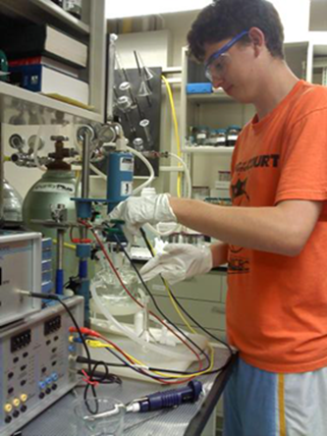
Freshman S-STEM Scholars Program (FSSP)
Scholarships in Science, Technology, Engineering, and Mathematics (S-STEM)
For Biomedical, Chemical, and Environmental Engineering Freshman Students at the University of Cincinnati
Do I Qualify?
To qualify to participate in the FSSP …
You must desire be successful in college and in your career
You must be a member of an underrepresented minority
You must demonstrate your commitment to succeed
A Scholarship Program Providing
Student Support
Academic Support
Tuition Compensation
Enriching Experiences
I Want to Know More!
For more information about joining the FSSP, please visit our website:
https://www.ceas3.uc.edu/sstem-bcee/fssp.php
or contact:
Dr. Anant R. Kukreti
Department of Biomedical, Chemical and Environmental Engineering
College of Engineering and Applied Science
University of Cincinnati
Cincinnati, OH 45221-0012
Phone: 513-556-4105
Fax: 513-556-6754 / 513-556-4162
E-Mail: anant.kukreti@uc.edu
FSSP Goals:
To produce Biomedical, Chemical and Environmental Engineering students who are prepared well to excel in their undergraduate program and become leaders during their academic and future careers.
FSSP students will also receive special training that will enhance competitiveness for admission into the larger, four-year S-STEM program, a program that provides increased financial and academic support, including accelerated graduate degrees.
All FSSP Participants Receive $1500 during their Freshman Year!
In Addition To Providing Financial Support,
FSSP …
Promotes productive academic relationships among students, faculty and other professionals
Provides
  Mentoring
  Workshops
  Seminars
  Learning Community
  Priority consideration for admission into the larger S-STEM program
I Want to Apply!
To submit an application, please visit the following website:
https://www.ceas3.uc.edu/sstem-bcee/apply/
S-STEM Is Funded By The
National Science Foundation
Grant #1356656
College of Engineering and Applied Science

