Slide 1
Applications of Nanotechnology in Health and Beauty Products
Tracy G. Howard, Woodward Career Technical H.S.
Michelle Marlow, Hughes STEM H.S.

Slide 2
The Participants

Slide 3
Outline
Objectives
Background
Research
Conclusion
Acknowledgments

Slide 4
Objectives
Analyze the importance of size
Synthesis of nanoparticles
Identify and characterize nanoparticles in health and beauty

Slide 5
Background and Motivation
Daizy Philip-green synthesis of metallic nanoparticles
Can we actually make silver and gold?
Nanotechnology and nanoparticles awareness

Slide 6
Size
1 nm = 10⁻⁹ m
Nanoparticle =?
Why is size importance?
Chemical features
Reactivity
Color

Slide 7
Synthesis of Metallic Nanoparticles
Green synthesis
Gold via Honey
Gold via Hibiscus plant
Silver via chemicals & Geranium plant

Slide 8
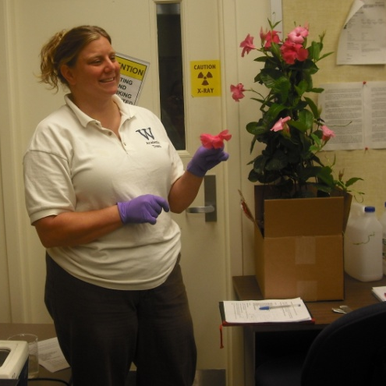
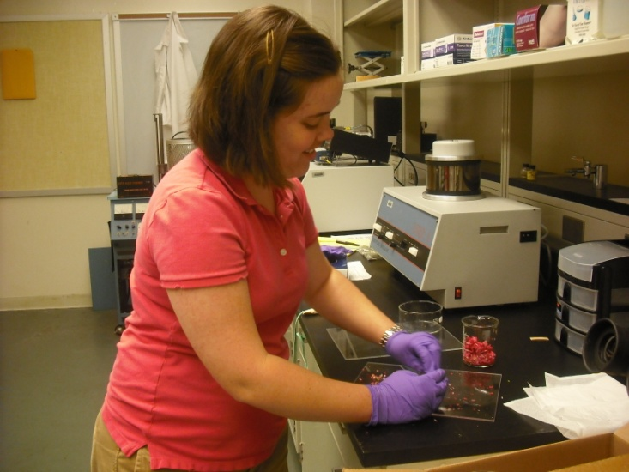
Synthesis

Slide 9
Microscopy and Spectroscopy Instruments
Dynamic Light Scattering (DLS)
Ultraviolet-visible spectroscopy (UV/Vis)
Scanning Electron Microscope (SEM)
Transmission Electron Microscope (TEM)

Slide 10
Scanning Electron Microscope
Electron Beam
Magnification capabilities
EDAX software
Uses

Slide 11
Characterization-Scanning Electron Microscope
500 nm

Slide 12
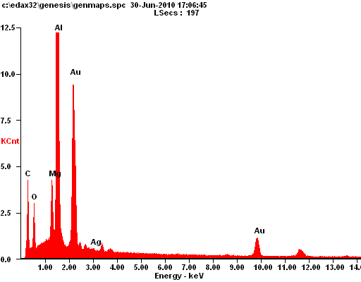
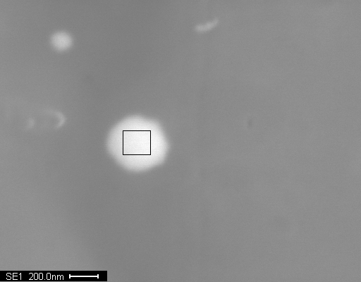
EDAX Software
Elemental analysis confirms the nanoparticles are gold
200 nm

Slide 13
Health and Beauty
Synthetic vs. ‘natural’ make up
Synthetic
Natural

Slide 14
Conclusion
Appreciation of nanotechnology and nanoparticles
Successful synthesis of gold
Application, Careers, Society

Slide 15
Future Work
Continue to explore green synthesis of metallic nanoparticles
Composition of make up
Negative factors of nanoparticles to the environment

Slide 16
Acknowledgments
Dr. Doug Kohls (Project PI)
Kelly Cross (GA)
Andrea Burrows (Grant Coordinator)
Dr. Anant Kukreti (Lead PI)

