Slide 1
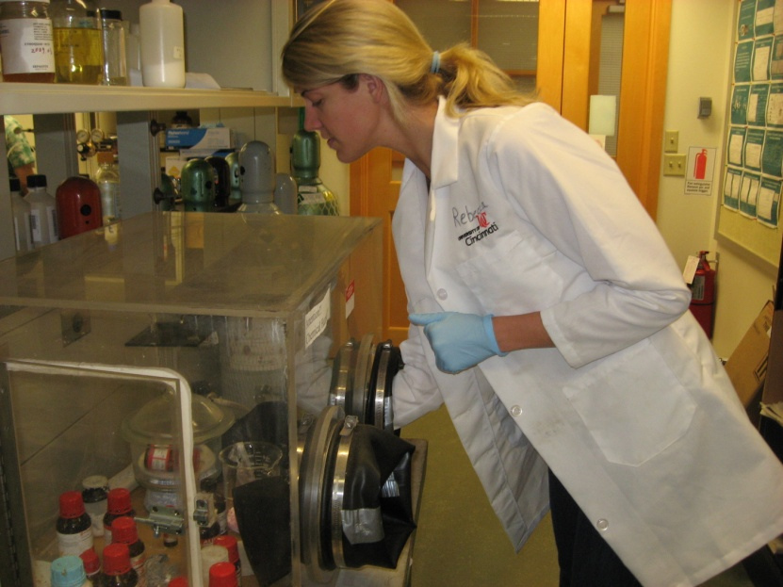
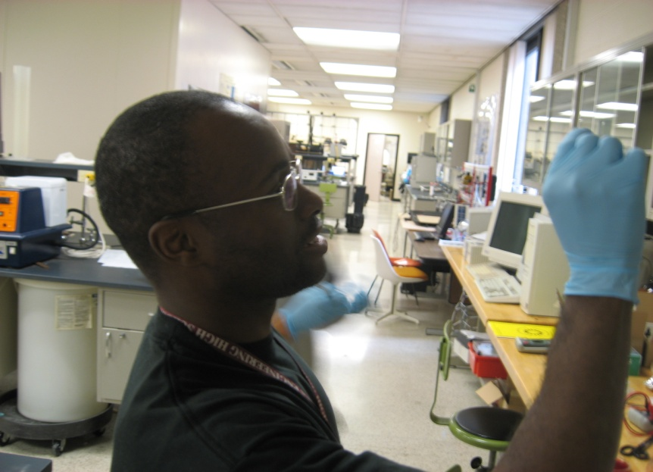
Project #4: Renewable Energy System
P.I.: Vesselin Shanov
G.A.: Feng Wang
Teacher - Deon Edwards
Teacher - Stephanie Baldwin

Slide 2



Fossil Fuels
85% of American energy
Growing Demand
Finite supply
Negative Environmental Effects
Notes:
Energy is essential. Over 85% of our energy needs comes from burning fossil fuels. Finite resource that causes environmental consequences for wildlife, air polllutionAmerica is at an energy crossroad. As a nation, we are dependent on fossil fuels at a time of growing demand and dwindling supply. Meanwhile, fossil fuel use continues to impose massive environmental and economic costs. Now our country must choose between paying to continue the status quo and investing in a new energy future.

Slide 3
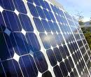
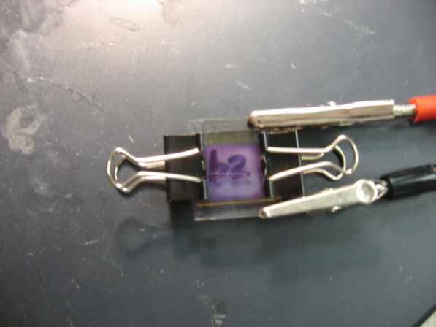
Solar Energy
Does not pollute
Unending supply
Does not emit greenhouse gas
Two-types
  Silicon Solar Cell
  Nanocrystalline TiO₂
Silicon Solar Cell
Nanocrystalline TiO₂

Slide 4
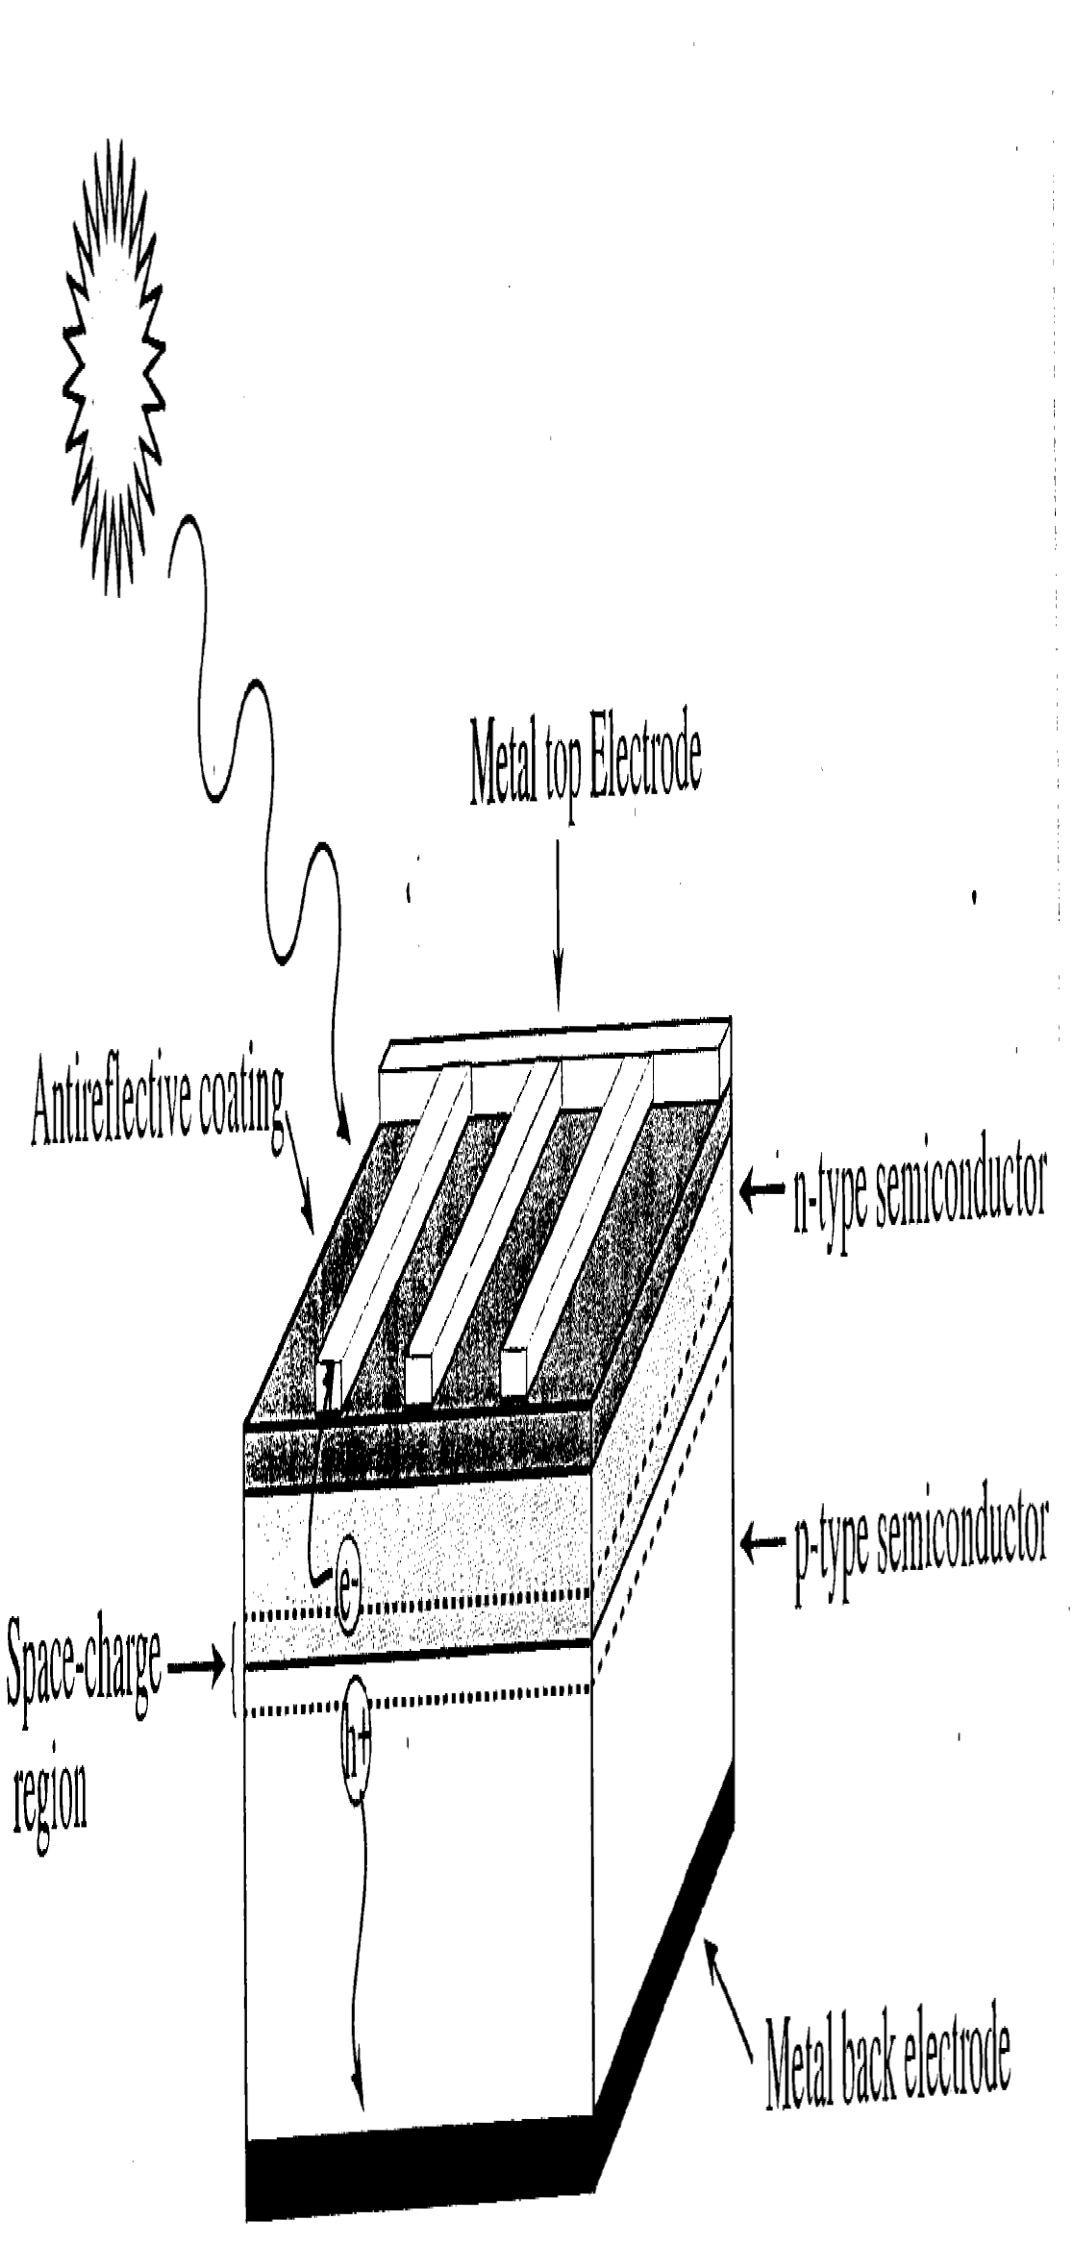
Silicon Solar Cells
Wide spread
Expensive to produce
Notes:
H+=hole that becomes positively charges
Silicon is a semiconductor

Slide 5
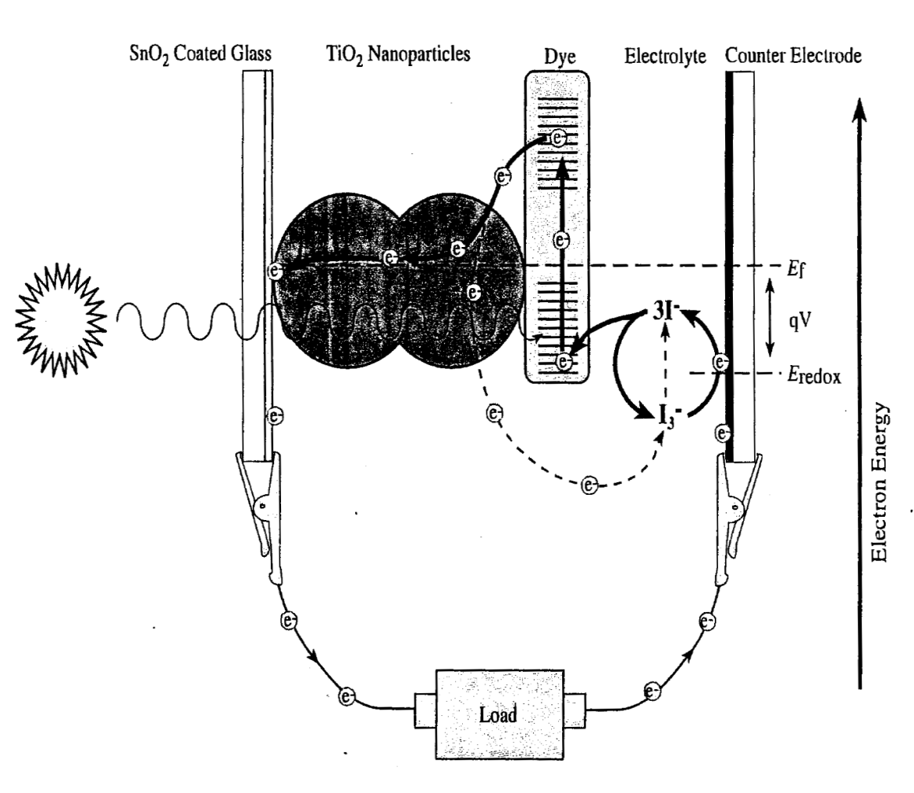
Dye-Sensitized TiO₂ Solar Cell
Based on photosynthesis
Newer, less proven
Inexpensive to produce
Notes:
Replicates photosynthesis

Slide 6



How Dye Sensitized Solar Cells work
Electrode Glass plate
TiO² Coating with Spinach Dye
Electrolyte
(Iodine)
e
Counter Electrode Glass plate
Carbon Layer
(use for catalyst)

Slide 7
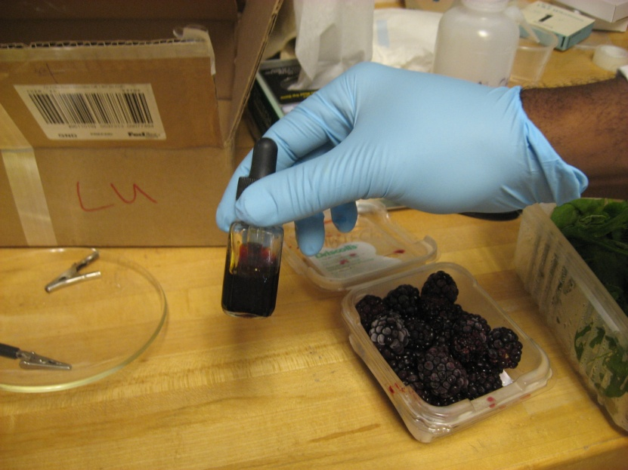
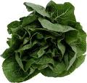
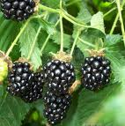
Dyes
Organic
Cheaper
More widely available
  Raspberry
  Blackberries
  Green Leaves
Synthetic
Expensive
Not widely available

Slide 8
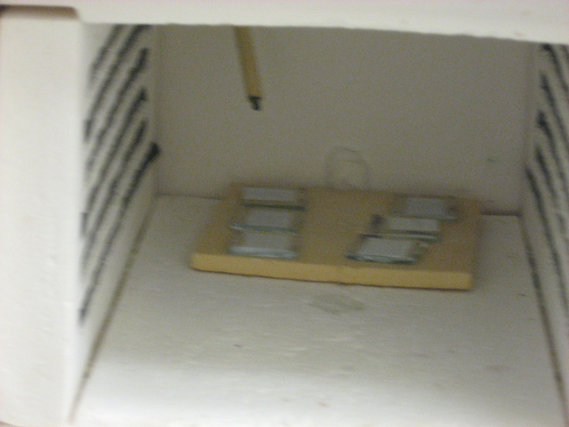
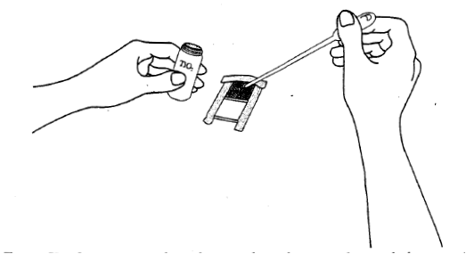
Dye Solar Cell Procedure
Step 1: Prepare conductive plates with tape and apply the TiO₂ film
Step 2: Bake plates
Notes:
Orientation of conductive glass plates
Masking of plates
Application of TiO₂ to the surface of the conductive plate

Slide 9
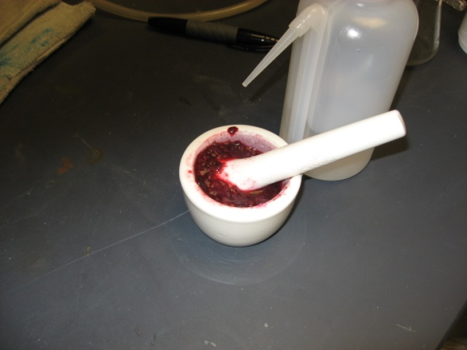
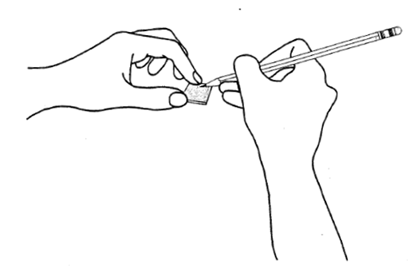

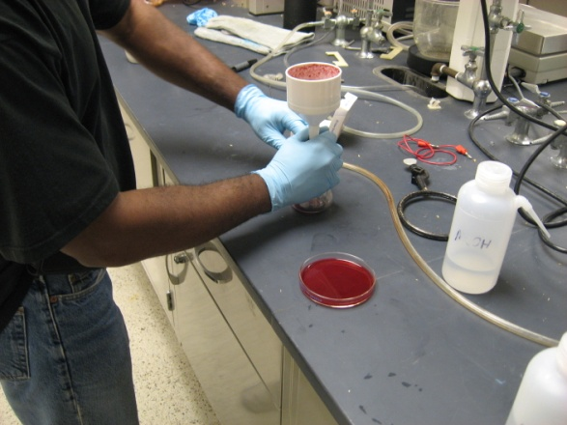
Procedure-continued
Step 3: Dye the plates
Step 4: Assemble Cell

Slide 10
Testing and Data
Testing completed using a solar simulator and automated multimeter
Data Collected
  Current
  Voltage
Notes:
The testing was completed using a solar simulator collecting data to find the short circuit current and open circuit voltage for our dyed solar cells. These point are obtained by find the y and x intercept, respectively, for each set of data.
The maximum power was also found by finding the highest power density value between the short circuit current and open circuit voltage. By comparing the max power values with the sun’s typical output of approximately 80-100 mW/cm², the cell efficiency was calculated

Slide 11
Calculations
Current Density
  C_{D} = Current x Area
Power Density
  P_{D} = Current Density x Voltage
Notes:
The testing was completed using a solar simulator collecting data to find the short circuit current and open circuit voltage for our dyed solar cells. These point are obtained by find the y and x intercept, respectively, for each set of data.
The maximum power was also found by finding the highest power density value between the short circuit current and open circuit voltage. By comparing the max power values with the sun’s typical output of approximately 80-100 mW/cm², the cell efficiency was calculated

Slide 12
Results

Slide 13
Results
Notes:
The testing was completed using a solar simulator collecting data to find the short circuit current and open circuit voltage for our dyed solar cells. These point are obtained by find the y and x intercept, respectively, for each set of data.
The maximum power was also found by finding the highest power density value between the short circuit current and open circuit voltage. By comparing the max power values with the sun’s typical output of approximately 80-100 mW/cm², the cell efficiency was calculated

Slide 14
Results
Dye Type | Short Circuit Current | Open Circuit Voltage
Synthetic | .55 mA/cm² | 215 mV
Blackberry | .27 mA/cm² | 45 mV
Spinach | .30 mA/cm² | 305 mV
Dye Type | Short Circuit Current | Open Circuit Voltage
Synthetic | .55 mA/cm² | 215 mV
Blackberry | .27 mA/cm² | 45 mV
Spinach | .30 mA/cm² | 305 mV
Notes:
The testing was completed using a solar simulator collecting data to find the short circuit current and open circuit voltage for our dyed solar cells. These point are obtained by find the y and x intercept, respectively, for each set of data.
The maximum power was also found by finding the highest power density value between the short circuit current and open circuit voltage. By comparing the max power values with the sun’s typical output of approximately 80-100 mW/cm², the cell efficiency was calculated

Slide 15

Our conclusion
Questions?

Slide 16

ACKNOWLEDGEMENTS
Sincere thanks to . . .
National Science Foundation.
Anant R. Kukreti, Associate Dean for Engineering Education Research and Professor, Department of Civil and Environmental Engineering, for leading the project.
Dr. Vesslin Shanov
Feng Wang
Andrea Burrows, for her logistical support.

