Slide 1
Biodiesel for Research and Education
Research Presentation
Jennifer Keiner
Chris Behm

Slide 2
Overview
Goals
Background
Procedures
Results & Conclusions
Future Research

Slide 3
Goals
Determine the effect of parameters on the conversion of free fatty acids(FFA) of waste cooking oil(WCO)
Investigate effect of citric acid washings on water consumption for biodiesel purification processes
Analyze and compare biodiesel produced using methanol and ethanol

Slide 4
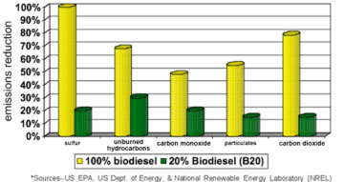
Background
Biodiesel research started as an alternative fuel source to petroleum derived diesel, benefits include:
A renewable energy resource
Able to be blended with traditional diesel
Less particulate matter, CO2 emissions, and sulfur dioxide emission

Slide 5
Background Cont.
Potential Problems
Production consumes a lot water, especially during feedstock development (growth of soybean)
Solutions
Alternative feedstock that uses less water can be of great interest such as waste cooking oil
Less water intensive techniques should be used for biodiesel purification methods (citric acid wash)

Slide 6
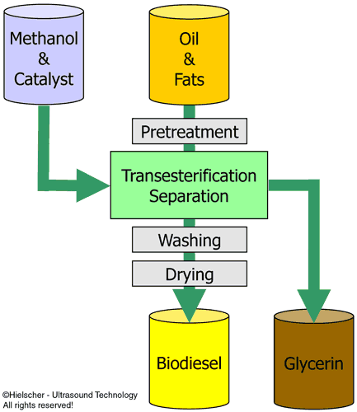

Slide 7
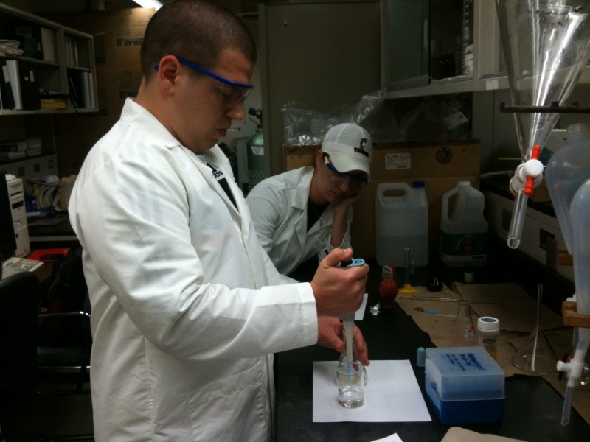
Procedure
Acid Pre-treatment
Materials:
Waste cooking oil
Methanol, 50:1 molar ratio
H₂SO₄: (15% wt of FFA)
Indicator solution
Procedure:
Prepare materials according to theoretical calculations
Heat the oil to 56 C
Add the sulfuric acid and methanol mixture
Draw samples
Titrate with NaOH to determine FFA

Slide 8
Results & Conclusions
Conversion of FFA Graph
FFA
Conversion
Time (Minutes)

Slide 9
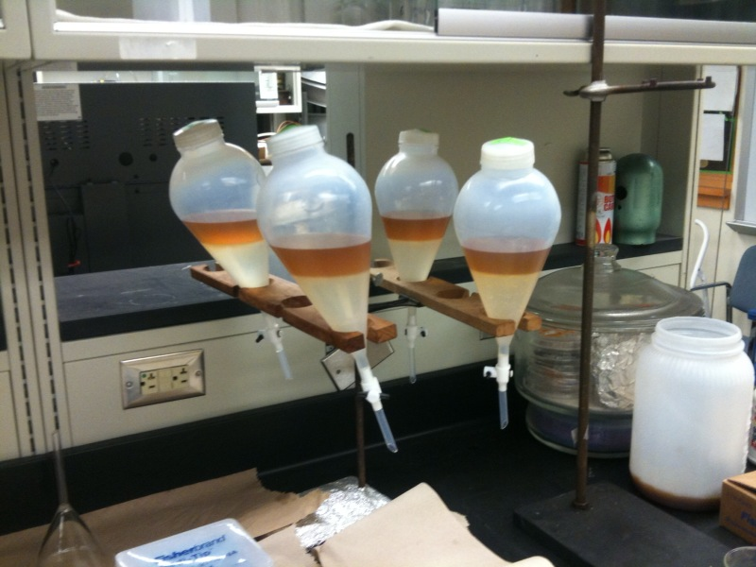
Procedure
Citric Acid Wash
Materials:
Crude biodiesel
1:1 ratio of wash of water, 2%, 3%, and 4% citric acid solution to biodiesel
Procedure:
Separate crude biodiesel into 4 separation funnels.
Add the four types of washes to each funnel.
Let sit for 30 minutes.
Drain the washing solution.
Take a 3 mL sample of the biodiesel.
Repeat until water comes clear..
In a test tube mix, biodiesel sample, methanol and shake for 10 seconds.
Impurities will settle to the bottom allowing identification of the best washing solution.

Slide 10
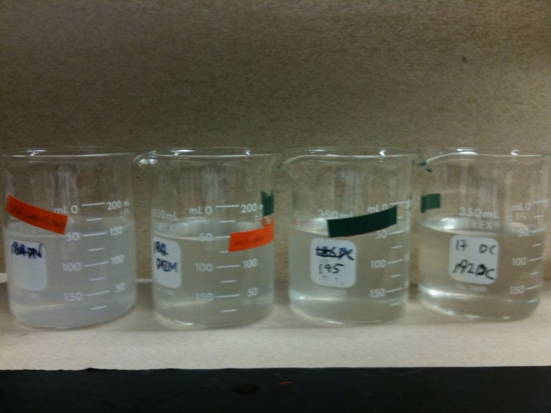
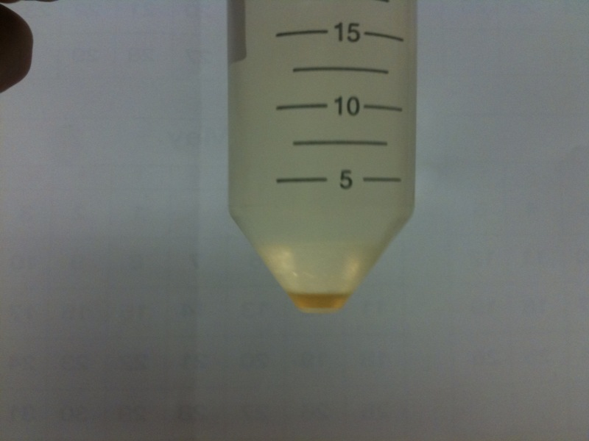
Results & Conclusions
Left picture: Waste water from biodiesel washing.
Left was only water and was cloudy after the 2nd wash.
Water was not as effective as citric acid solution after the first and second wash.
Concentration of citric acid had a minimal effect.

Slide 11
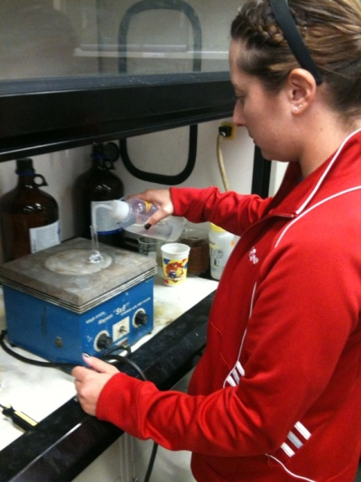
Procedure
Production comparing methanol and ethanol
Materials
Canola oil produced with ethanol and methanol
WCO from different sources produced with methanol
Procedure
Produce biodiesel by transesterfication
Wash biodiesel
Dilute biodiesel with DCM for use in GC
Run samples through the GC
Dilution of Biodiesel

Slide 12
GC Results
Different oil sources can yield different biodiesel ester profiles.
Waste cooking oil and virgin canola produce similar components.
WCO and virgin canola oil produce different relative amounts of components.
Alcohols have direct influence on composition of biodiesel.

Slide 13
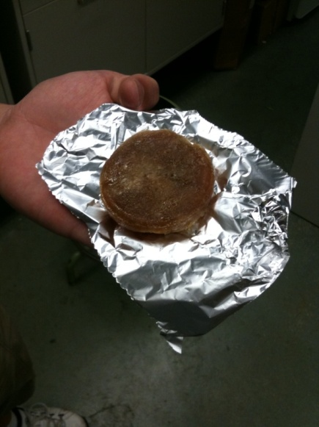
Future Work
Determine if any other substances will allow for less water to be used in the biodiesel production.
Investigate the kinetics of the acid pretreatment.
Explore the next generation of biodiesel feedstock.
Explore uses of glycerin byproduct of biodiesel for making soap.
Glycerin Soap

Slide 14
Thank You To
Dr.Mingming Lu, Faculty Mentor
Qingshi Tu, Graduate Assistant
Ming Chai, Graduate Assistant
Andrea Burrows, Grant Coordinator
Dr.Anant Kukreti, Principle Investigator

