Slide 1


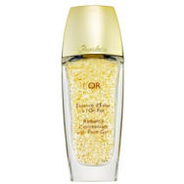
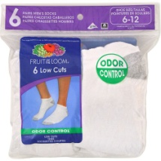

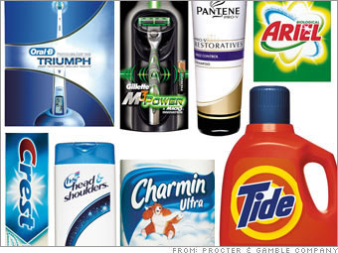
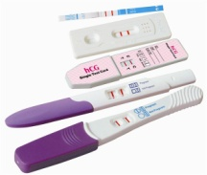
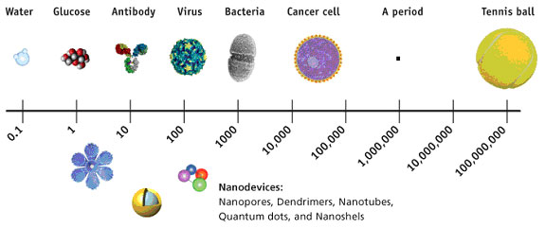

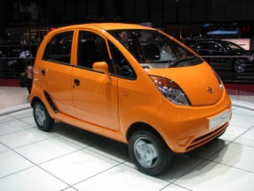
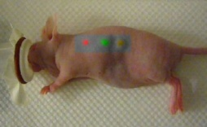
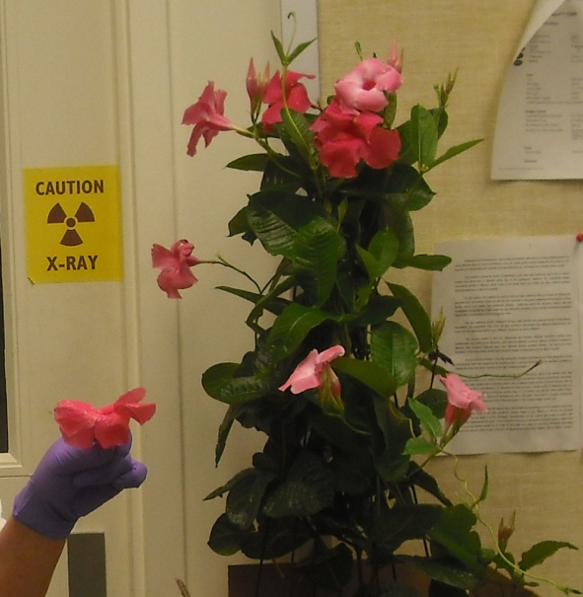
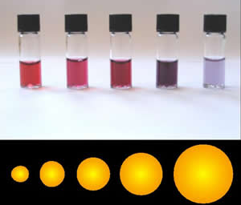
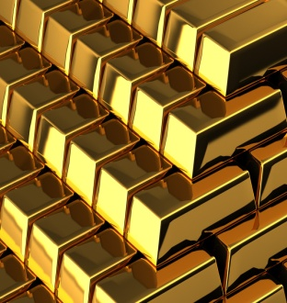
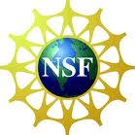
Applications of Nanotechnology in Health & Beauty Products
Tracy G. Howard, Michelle Marlow, Cincinnati, OH, Cincinnati Public Schools
- Nanoparticles behave differently than bulk
- Understand nanoparticles influence substrate
-Bulk vs. nano properties of gold
- “Green” nano Au synthesis using Gold salt and plants
-Visualize color change at nano level by adding salt to aggregate particles
-Explain why properties sometimes differ
-Demonstrate nano particle size influences substrate
-Describe an application and its possible effect on society
Abstract
Nanotechnology has become the new cutting edge science. The size and scale at the nano level is a difficult concept for students. These lessons provide an introduction to nanoscience, focusing on concepts related to the size and scale, unusual properties of the nanoscale, and example applications of nanoscience. Students will better understand size dependent effects that are not observed in bulk materials using gold. Students will have a better appreciation of the nanoparticles and the implications it has in every aspect of their lives.
National Science Standards 9-12
A: Science as Inquiry F: Science in Personal & Social
B: Physical Science Perspectives
E: Science and Technology G: History and Nature of Science
Misconceptions
Material properties do not change with size.
People are not effected by Nanoparticles.
Background
Properties of matter, Human impact, Experimental procedures, Familiarity with atoms. Knowledge of basic units of the metric system
Modifications
Silver Nitrate can be substituted for cost and classroom examples: microbial consumer products: socks, pants, shirts, band-aids.
Extensions: Microscope unit for scale, antimicrobial lesson using synthesized nanoparticles and yeast. Trip to university with SEM.
Acknowledgements
Dr. Anant Kukreti (Lead PI) Andrea Burrows (Grant Coordinator)
Dr. Doug Kohls (Project PI) Kelly Cross (GA)
  RET funded by NSF grant EEC-0808696
References
Huang, H. and X. Yang, Synthesis of polysaccharide-stabilized gold and silver nanoparticles: a green method. Carbohydrate Research, 2004. 339(15): p. 2627-2631.
Min, Z. et al., Minute synthesis of extremely stable Au nanoparticles. Nanotechnology, 2009. 20(50): p. 505.
McFarland, A.et al., Color My Nanoworld. Journal Chemical Ed, 2004,, 81(4): p 544.
Philip, D., Green synthesis of gold and silver nanoparticles using Hibiscus rosa sinensis.
Real Life Applications
Society Impact
Informative understanding- SPENDING consumer & government
2 million U.S. nano workers needed by 2015
5 million additional related jobs
http://www.nano.gov/html/edu/careers.htm
Unlimited Career Connections
Learning Goals
Learning Activities
Assessment
Get Rich Quick Lesson Plan 1- Too Small To See
Term “nano”
Scale (km to nm)
Draw in scale
Discussion of Scale
Scale Video
Measurement Activity
Cutting activity
Drawing in scale
Visually demonstrate scale (poster,video, power point, 3D model)
Get Rich Quick Lesson Plan 2- What Color is Gold!
Nanotechnology
Biologist
Engineer
Chemist
Physicist
Environmentalist
Molecular Biologist
Materials Scientist
Green Chemistry Color vs. Particle Size Bulk Particle Size

