Slide 1
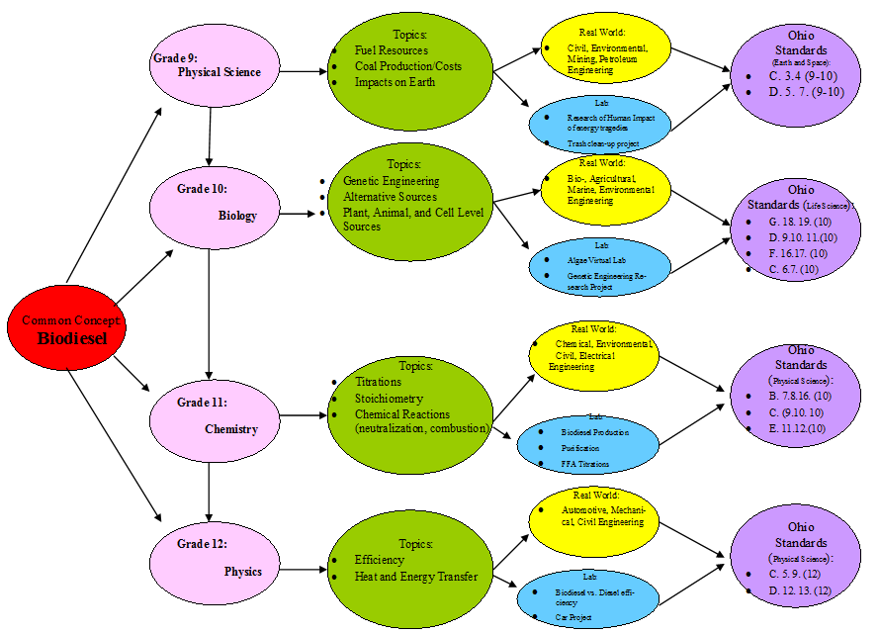
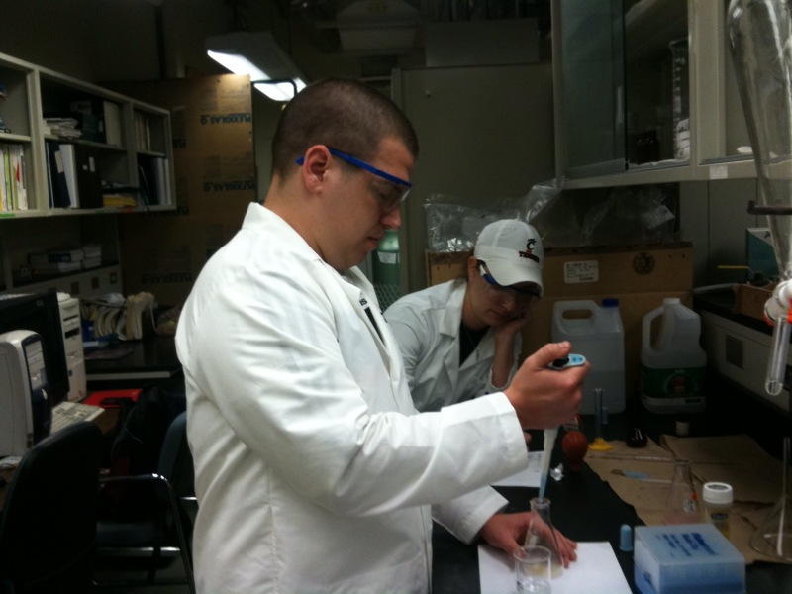
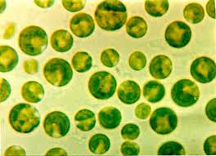
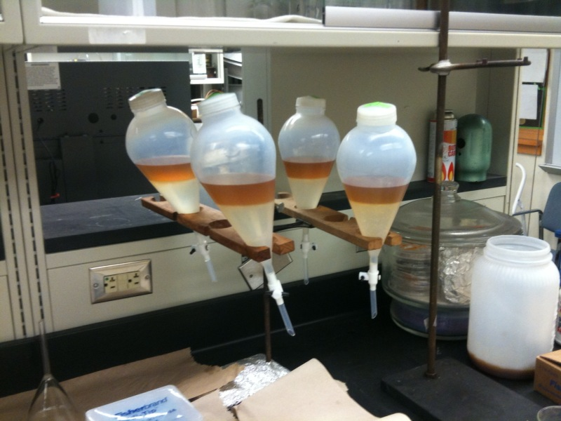
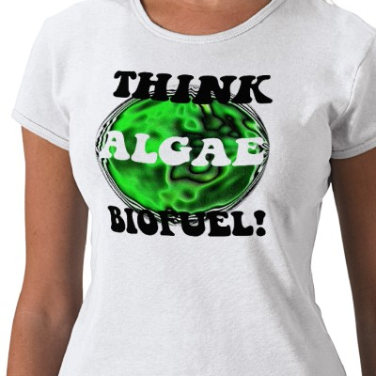
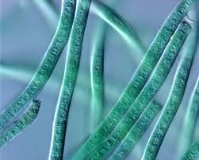
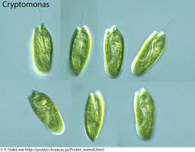
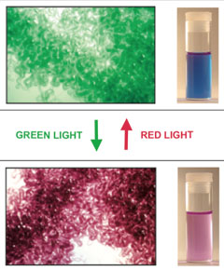
Making Biodiesel For Research and Education ¹Chris Behm, ²Jennifer Keiner, ³Quingshi Tu, ³Dr.Mingming Lu ¹Riverview East Academy, Cincinnati, OH, ²University of Cincinnati, Cincinnati, OH, ³ Department of Engineering, University of Cincinnati, Cincinnati, OH
Biology
Day 1 – Review of photosynthesis and lab set up; algae preparation, lighting preparation and safety.
Day 2-5- Observation; monitoring of oxygen levels and algae growth.
Day 6 – Lab write up; included is whether algae can become a sustainable fuel source.
Day 7 – Labs are turns in and peer reviewed.
Application
Application is possible over all content areas of high school science courses; biodiesel allows for discussion and activities over alternative fuel sources, chemical reactions, stoichiometry, titration, genetic engineering, fuel efficiency, human impact on the environment and work and energy production.
Careers
Engineering careers include bio-engineers, environmental engineers, civil engineers, mechanical engineers, chemical engineers and agricultural engineers.
Society
Production of biodiesel can lower emission of harmful pollutants; such as sulfur oxide, nitrogen oxides, ozone and Particulate matter. Reduction in these pollutants will drastically improve the health of people with repertory problems.
Chemistry
Day 1 – Background information on biodiesel and Free Fatty Acid pretreatment demonstration. Picture below.
Day 2 – Calculation of reaction chemicals needs and biodiesel production.
Day 3 – Biodiesel purification and washing. Separator funnels for washing below.
`
Day 4 – Gas chromatography result analysis and efficiency test. GC shown on left.
Goals | Objectives
Students can relate the photosynthetic process with plant life in a real world scenario | Students will be able to: Illustrate the photosynthetic cycle Describe under what conditions the algae has optimal growth Explain the conditions the algae produce the most oxygen
Students can understand the importance of alternative energy resources | Students will be able to: List ways why algae is an important alternative energy resource Describe how the lab is useful for algae cultivation Explain the process of biodiesel production from algae
Goals: | Objectives:
Students can relate the production of biodiesel to real world applications and professions | Students will be able to: Balance a chemical equation Indentify how changing the amount of chemicals in a reaction will change the results Correctly calculate a stoichiometric problem
Students can understand that science and chemistry are related to everything around them. | Students will be able to: Identify different types of chemical reactions
Algae | Picture
Chlorella
Phormidium
Crytomonas
Fremyella
Acknowledgements: Andrea Burrows, Anant Kukreti, Ming Chai
Project RET is funded through NSF Grant # EEC 0808696

