Slide 1
Applications of Nanotechnology in Health and Beauty Products
GET RICH QUICK!
A Nanoscale Production
Tracy G Howard Woodard- Career Technical H S
Michelle Marlow- Hughs STEM H S

Slide 2





The Experts

Slide 3
Talk Outline
WHY YOU SHOULD CARE
Lesson 1- What Color Is Gold!
Lesson 2- Too Small To See?
WHY YOUR STUDENTS WILL CARE
Notes:
Up and coming career connections- 7 million jobs by 2015
US gov’t 460 million in 2001 to 1 billion in 2005 for nanotechnology alone
Lessons
All products available now and they can create later

Slide 4
Objectives
Students will understand
  “nano”
  Scale (km to nm)
  Nanoparticles behave differently than bulk
  Nanoparticles influence substrate
  Green Chemistry
Notes:
Nano- billionth
Macro to nano- from universe to circuitry
Properties due to atomic forces not found in bulk
Clothing, drug delivery
Less harm to environment

Slide 5
National Standards 9-12
A: Science as Inquiry
B: Physical Science
E: Science and Technology
F: Science in Personal & Social Perspectives
G: History and Nature of Science
Notes:
A- how systems function & technology to enhance gathering and manipulation of data
B- Chemical RXN & Motions and Forces
E- Ask questions, use different methods, accept different evidences & Advances with new technologies &pursue different reasons
F- Understanding concepts should active debate & Society decides on proposals on new research and technologies
G- Advances that important and long lasting effects on science and society

Slide 6
Background
Experimental procedures
Familiarity with atoms
Properties of matter
Knowledge of metric system
Human impact world

Slide 7
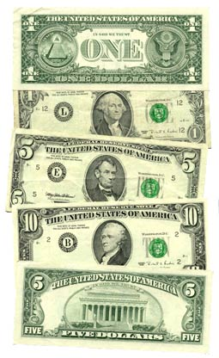
Lesson 1 What Color Is Gold?
GET RICH QUICK
Notes:
We can make million of millions of pieces of GOLD!

Slide 8
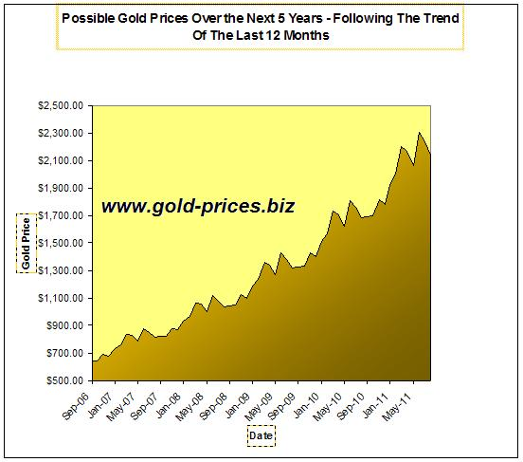
Sell Your Gold For Cash

Slide 9
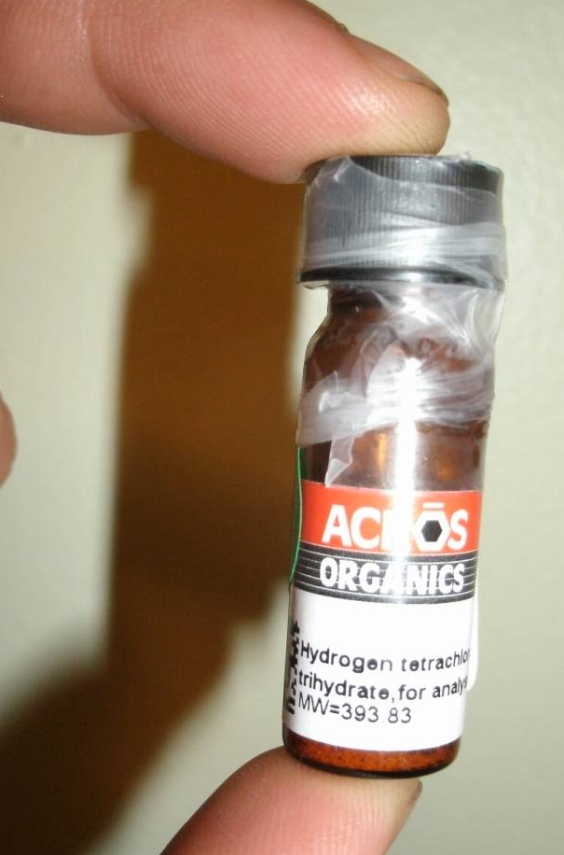
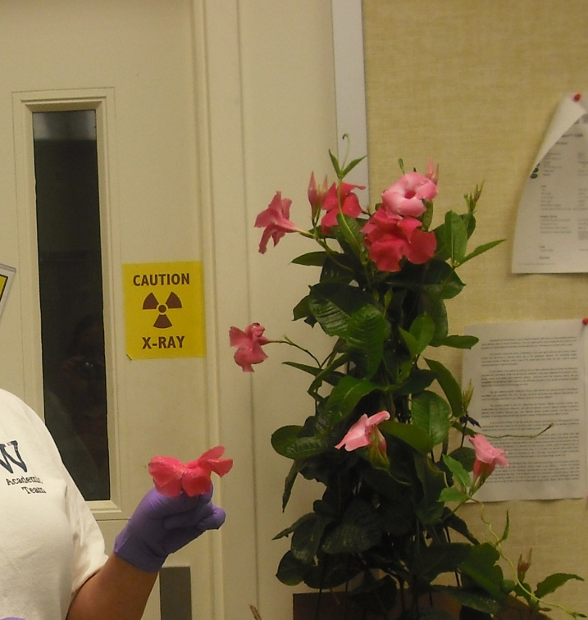
“Green Chemistry” Au Synthesis
Notes:
The Environmental Protection Agency defines green chemistry as the design of chemical products and processes that reduce or eliminate the use or generation of hazardous substances.

Slide 10
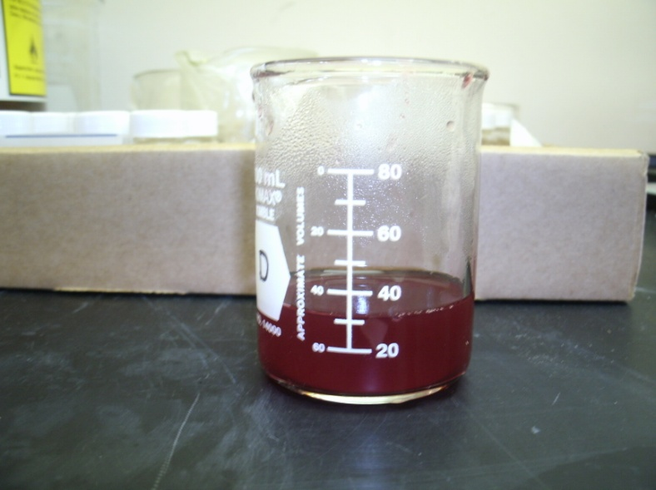
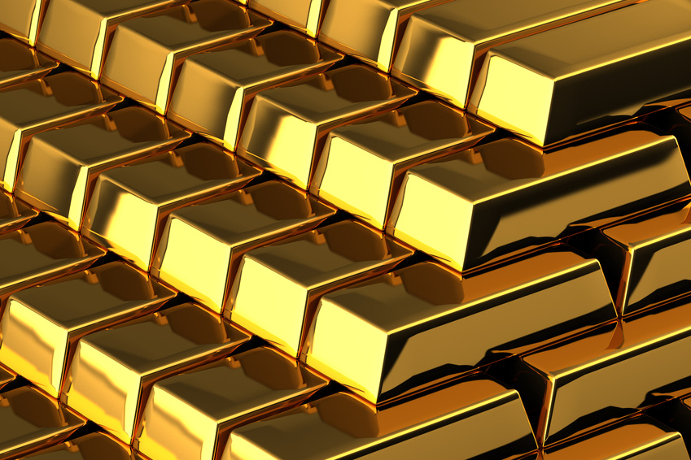
What Color Is GOLD???
Notes:
We get a red color… but gold should be gold??? What is going on???

Slide 11
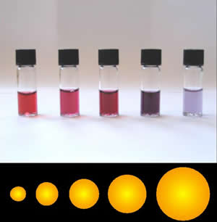
Visualize Change At Nano Level
Optical properties change due to size Au
Not observed in bulk
~13nm to ~100nm
http://www.webexhibits.org/causesofcolor/9.html
Notes:
As salt is added, the reduced Au particles start to aggregate together causing optical changes
Been recorded for over 100 years
Done in stain glass for 1500 years

Slide 12
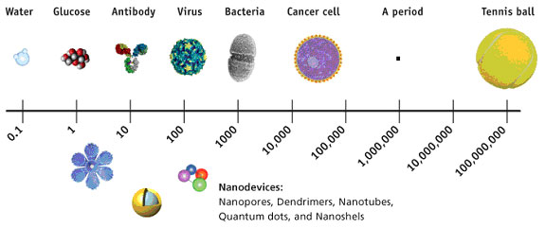
Lesson 2 Too Small To See?
Discussion of Scale (Video)
Measurement Activity

Slide 13
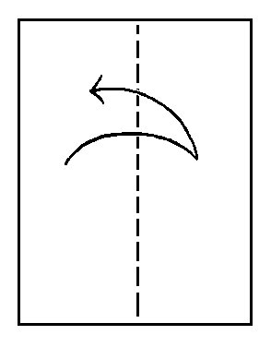

Demonstrate Size & Limitations

Slide 14


Misconceptions
Material properties do not change with size.
People are not effected by Nanoparticles.
.

Slide 15
Assessment
Draw in scale
Apply scale to substrate
Demonstrate nanoparticle size influences substrate
Visually demonstrate scale in a discipline (poster, powerpoint,video, 3D model)
Design future examples of applications

Slide 16

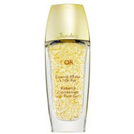
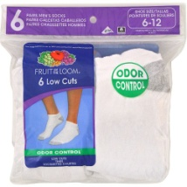
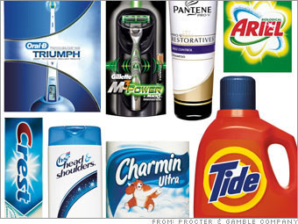
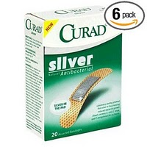
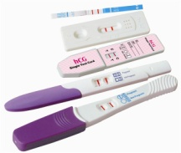

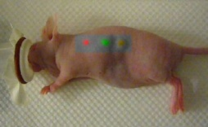
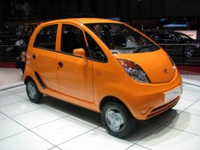
Application To Life
Consumer Products, Beauty, Electronics, Health, Medical, Manufacturing

Slide 17
Career Connections
Nanotechnology
Biologist
Engineer
Chemist
Physicist
Environmentalist
Molecular Biologist
Materials Scientist

Slide 18
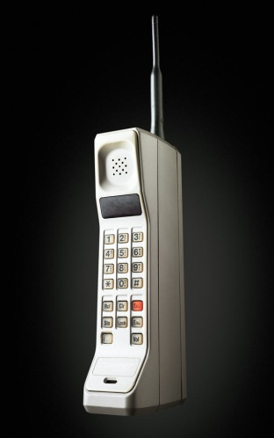
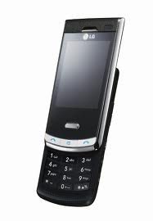
Society Impact
Informative understanding- SPENDING
2 million nano workers needed by 2015
5 million additional related jobs
http://www.nano.gov/html/edu/careers.htm
Notes:
US gov’t 460 million in 2001 to 1 billion in 2005 for nanotechnology alone

Slide 19
Lesson Summary
Green Chemistry
Scale
Properties (Optical)
Demonstrating scale using models
Real world connections
Notes:
Nano- billionth
Macro to nano- from universe to circuitry
Properties due to atomic forces not found in bulk
Clothing, drug delivery
Less harm to environment

Slide 20
Acknowlegements
Kelly J. Cross
Dr. Doug Kohls
Andrea Burrows
Dr. Anant Kukreti

Slide 21
QUESTIONS???????

