Slide 1
Biodiesel for Research and Education
Classroom Implementation
Jennifer Keiner, University of Cincinnati
Chris Behm, Riverview East Academy

Slide 2
Cross Content Approach
9th grade Physical Science
Current Fuel Sources, Problems, Alternatives
10th grade Biology
Biodiesel Sources, Genetic Engineering, Algae Growth Lab
11th grade Chemistry
Making Biodiesel, Chemical Reactions, Titration, Stoichiometry
12th grade Physics
Biodiesel Efficiency, Engine Efficiency, Energy/Work Production

Slide 3
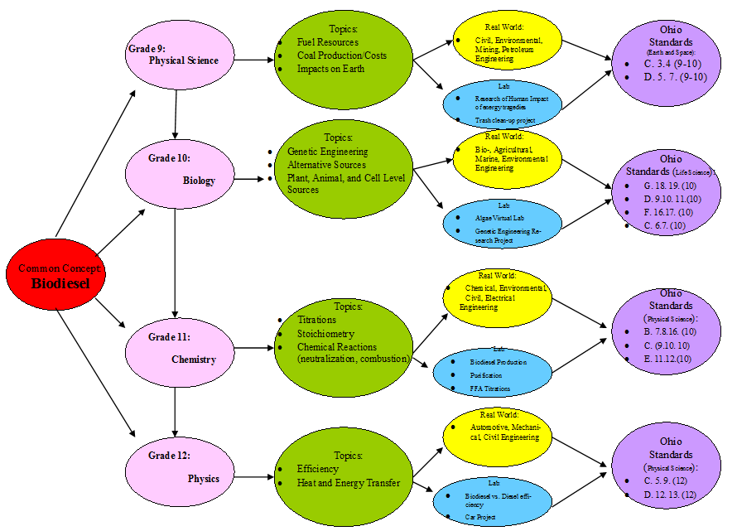
Content Map

Slide 4
Goal and Objectives
Biology Goals | Biology Objectives | Chemistry Goals | Chemistry Objectives
Students can relate the photosynthetic process with plant life in a real world scenario | Illustrate the photosynthetic cycle Describe under what conditions the algae has optimal growth Explain the conditions and algae that produces the most oxygen | Students can relate the production of biodiesel to real world applications and professions | Balance a chemical equation Indentify how changing the amount of chemicals in a reaction will change the results Correctly calculate a stoichiometric problem
Students can understand the importance of alternative energy resources | List ways why algae is important as an alternative energy Describe how the lab is useful for algae cultivation Explain the process of biodiesel production from algae | Students can understand that science and chemistry are related to everything around them. | Identify different types of chemical reactions

Slide 5
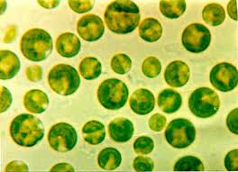
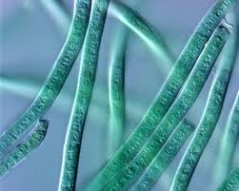
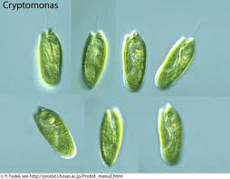
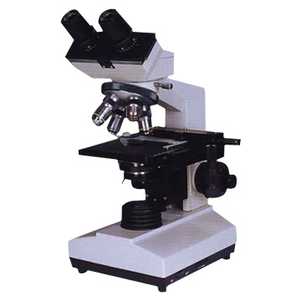
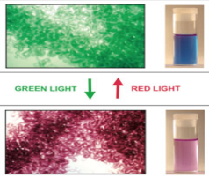
Biology Implementation
Algae: | Picture:
Chlorella
Phormidium
Crytomonas
Fremyella
From Plants to Power Plants
Photosynthesis lab incorporating algae as a biofuel
Day 1:
Photosynthesis Review
Lab safety
Algae Preparation
Environmental elements set-up
Day 2-5
Observation
Monitor oxygen levels and algae growth.
Look at algae growth through microscope

Slide 6
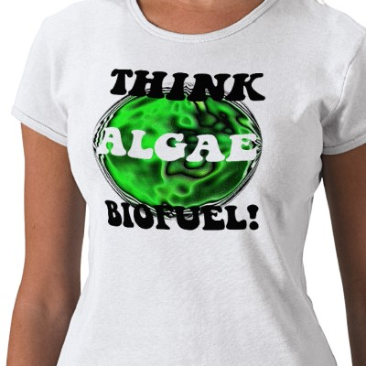
Biology Implementation
Day 6
Lab write up
Research on biodiesel made from algae
Day 7
Peer Review of lab reports
Lab report due

Slide 7
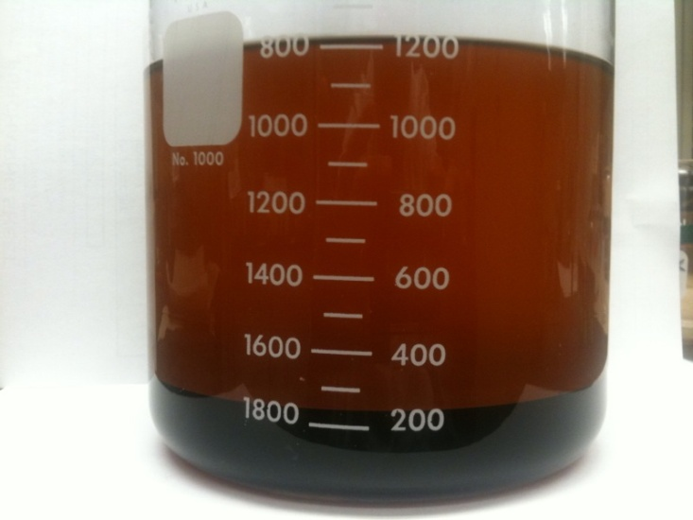
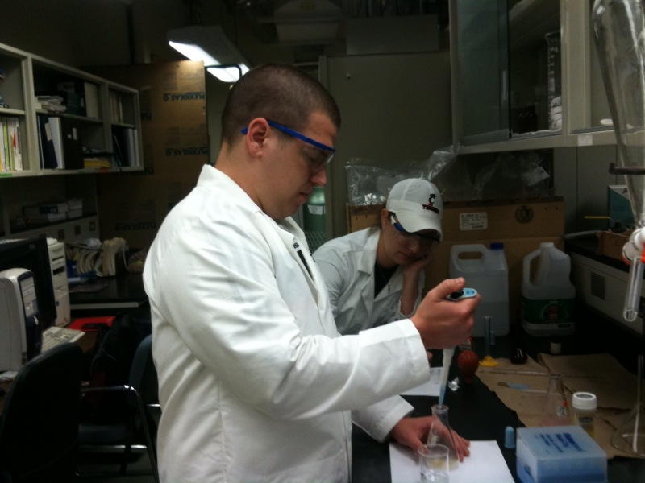
Chemistry Implementation
French Fries to Powering Cars
Day 1 - Background information on biodiesel and Free Fatty Acid pretreatment demonstration
Day 2 – Calculation of chemicals to make biodiesel and biodiesel production

Slide 8
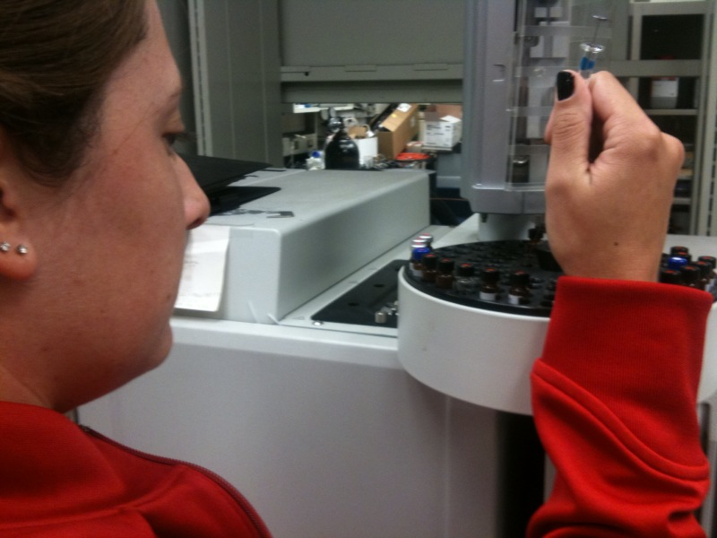
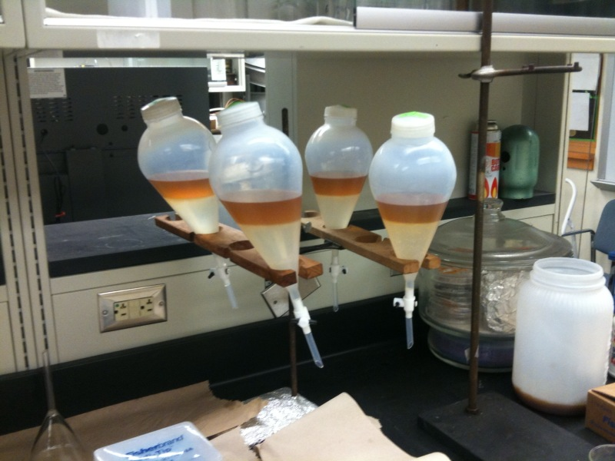
Chemistry Implementation
Day 3 – Separation of the biodiesel and glycerin and biodiesel washing and purification.
Day 4 – Gas chromatography analysis and efficiency test of biodiesel.

Slide 9
Physical Science/Physics Approach to Biodiesel
Physical Science
Learning about current fuel sources, problems and alternatives.
Physics
Energy Efficiency.
Testing Biodiesel against Traditional.

Slide 10
Thank You To
Dr.Mingming Lu, Faculty Mentor
Qingshi Tu, Graduate Assistant
Ming Chai, Graduate Assistant
Andrea Burrows, Grant Coordinator
Dr.Anant Kukreti, Principle Investigator

