Slide 1


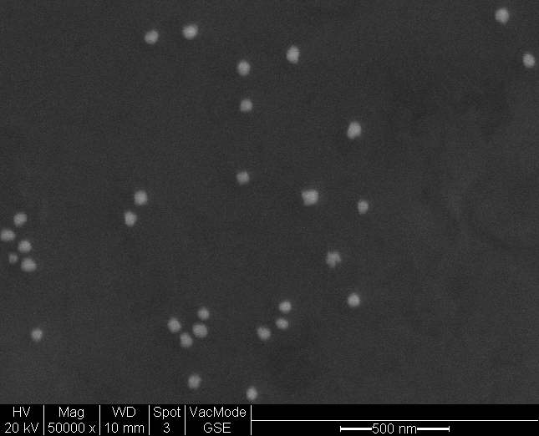
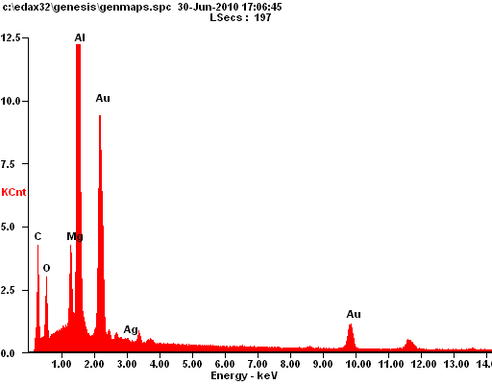
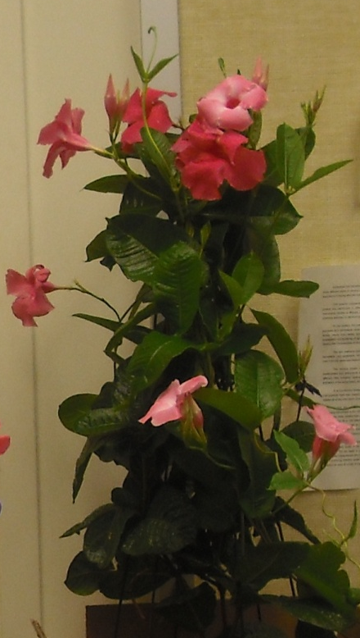
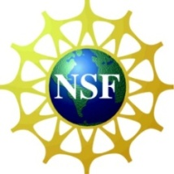
Applications of Nanotechnology in Health and Beauty Products
Tracy G. Howard, Michelle Marlow, Cincinnati, OH, Cincinnati Public Schools
Abstract
Nanotechnology and nanoparticles are rising in popularity; however, many people, do not understand the basic concepts of nanotechnology and the presence of nanoparticles. Understanding the synthesis and characterization of nanoparticles helps bridge that gap.
Introduction
Green synthesis will be used to produce Au (gold) nanoparticles and these will be characterized with a scanning electron microscope (SEM). The size will be found and the composition confirmed. Health and beauty products will also be identified and analyzed.
Methods
Gold synthesis via green technology
  Hibiscus plant extract
SEM and EDAX characterization
Synthetic vs. natural make up comparison
Results
SEM and EDAX data show nanoparticles and element composition
Conclusion
We successfully synthesized Au (gold) and determine the size of the nanoparticles using SEM. Differences in make up were observed.
Acknowledgements:
Dr. Doug Kohls (Project PI)
Kelly Cross (GA)
Andrea Burrows (Grant Coordinator)
Dr. Anant Kukreti (Lead PI)
Project RET is funded through NSF grant # EEC 0808696
We have gold!
500 nm
Count x 1000
SEM Image-Gold nanoparticles
50,000X magnification
Approx. 100 nm in size
Objectives
Analyze the importance of size
Explore the synthesis of nanoparticles
Synthesize and characterize gold nanoparticles via green synthesis
Identify and characterize nanoparticles in health and beauty
Energy keV
Elemental Analysis of nanoparticle using EDAX
Synthetic
Natural

