Slide 1
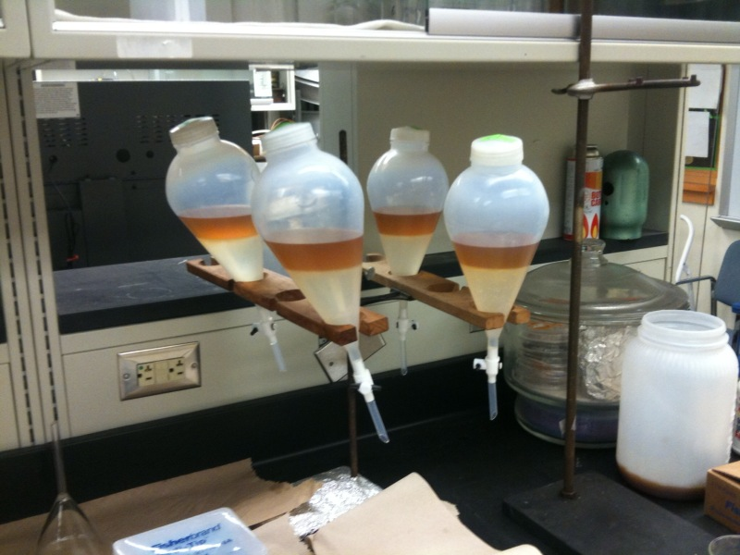
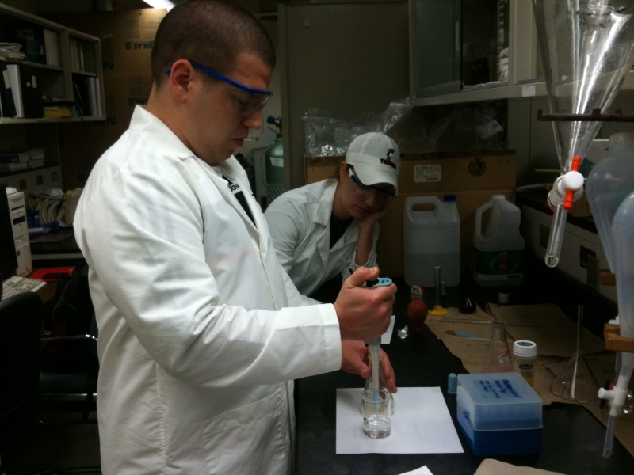
Making Biodiesel For Research and Education ¹Chris Behm, ²Jennifer Keiner, ³Quingshi Tu, ³Dr.Mingming Lu ¹Riverview East Academy, Cincinnati, OH, ²University of Cincinnati, Cincinnati, OH, ³ Department of Engineering, University of Cincinnati, Cincinnati, OH
Abstract
Biodiesel is a viable additive for mixing into traditional diesel fuel to lower harmful emissions, especially particulate matter. Biodiesel production is being held back due to large amounts of water having to be used in the production process. Determination of free fatty acids in waste cooking oil and purification with citric acid can be used to try to reduce the amount of water being used.
Methods
Pretreatment of fatty acid using sulfuric acid, methanol, ethyl alcohol and NaOH.
Washing and purification of biodiesel with different citric acid concentration.
Comparison of biodiesel produced with methanol and ethanol.
Data And Results
Future Work
Explore other options to reduce water usage.
Investigate acid pretreatment kinetics.
Explore other sources of biodiesel feedstock.
FFA Acid Pretreatment Graph
FFA Conversion
Minutes
Crude biodiesel being washed with water and different concentrations of citric acid.
Analysis and Conclusion
More sulfuric acid yielded higher conversion of FFA.
More time in the reactor yielded higher conversion of FFA.
58C reaction temperature yields a higher conversion than 56C.
50:1 methanol ratio yielded highest conversion of FFA.
Citric acid reduced the amount of water need for washing.
Citric acid concentration had minimal effect of water usage.
Different oil sources can yield different biodiesel ester profiles.
Waste cooking oil and virgin canola produce similar components.
WCO and virgin canola oil produce different relative amounts of components.
Alcohols have direct influence on composition of biodiesel.
Titration with NaOH to determine FFA content
Acknowledgements: Andrea Burrows, Anant Kukreti, Ming Chai
Project RET is funded through NSF Grant # EEC 0808696

