Slide 1
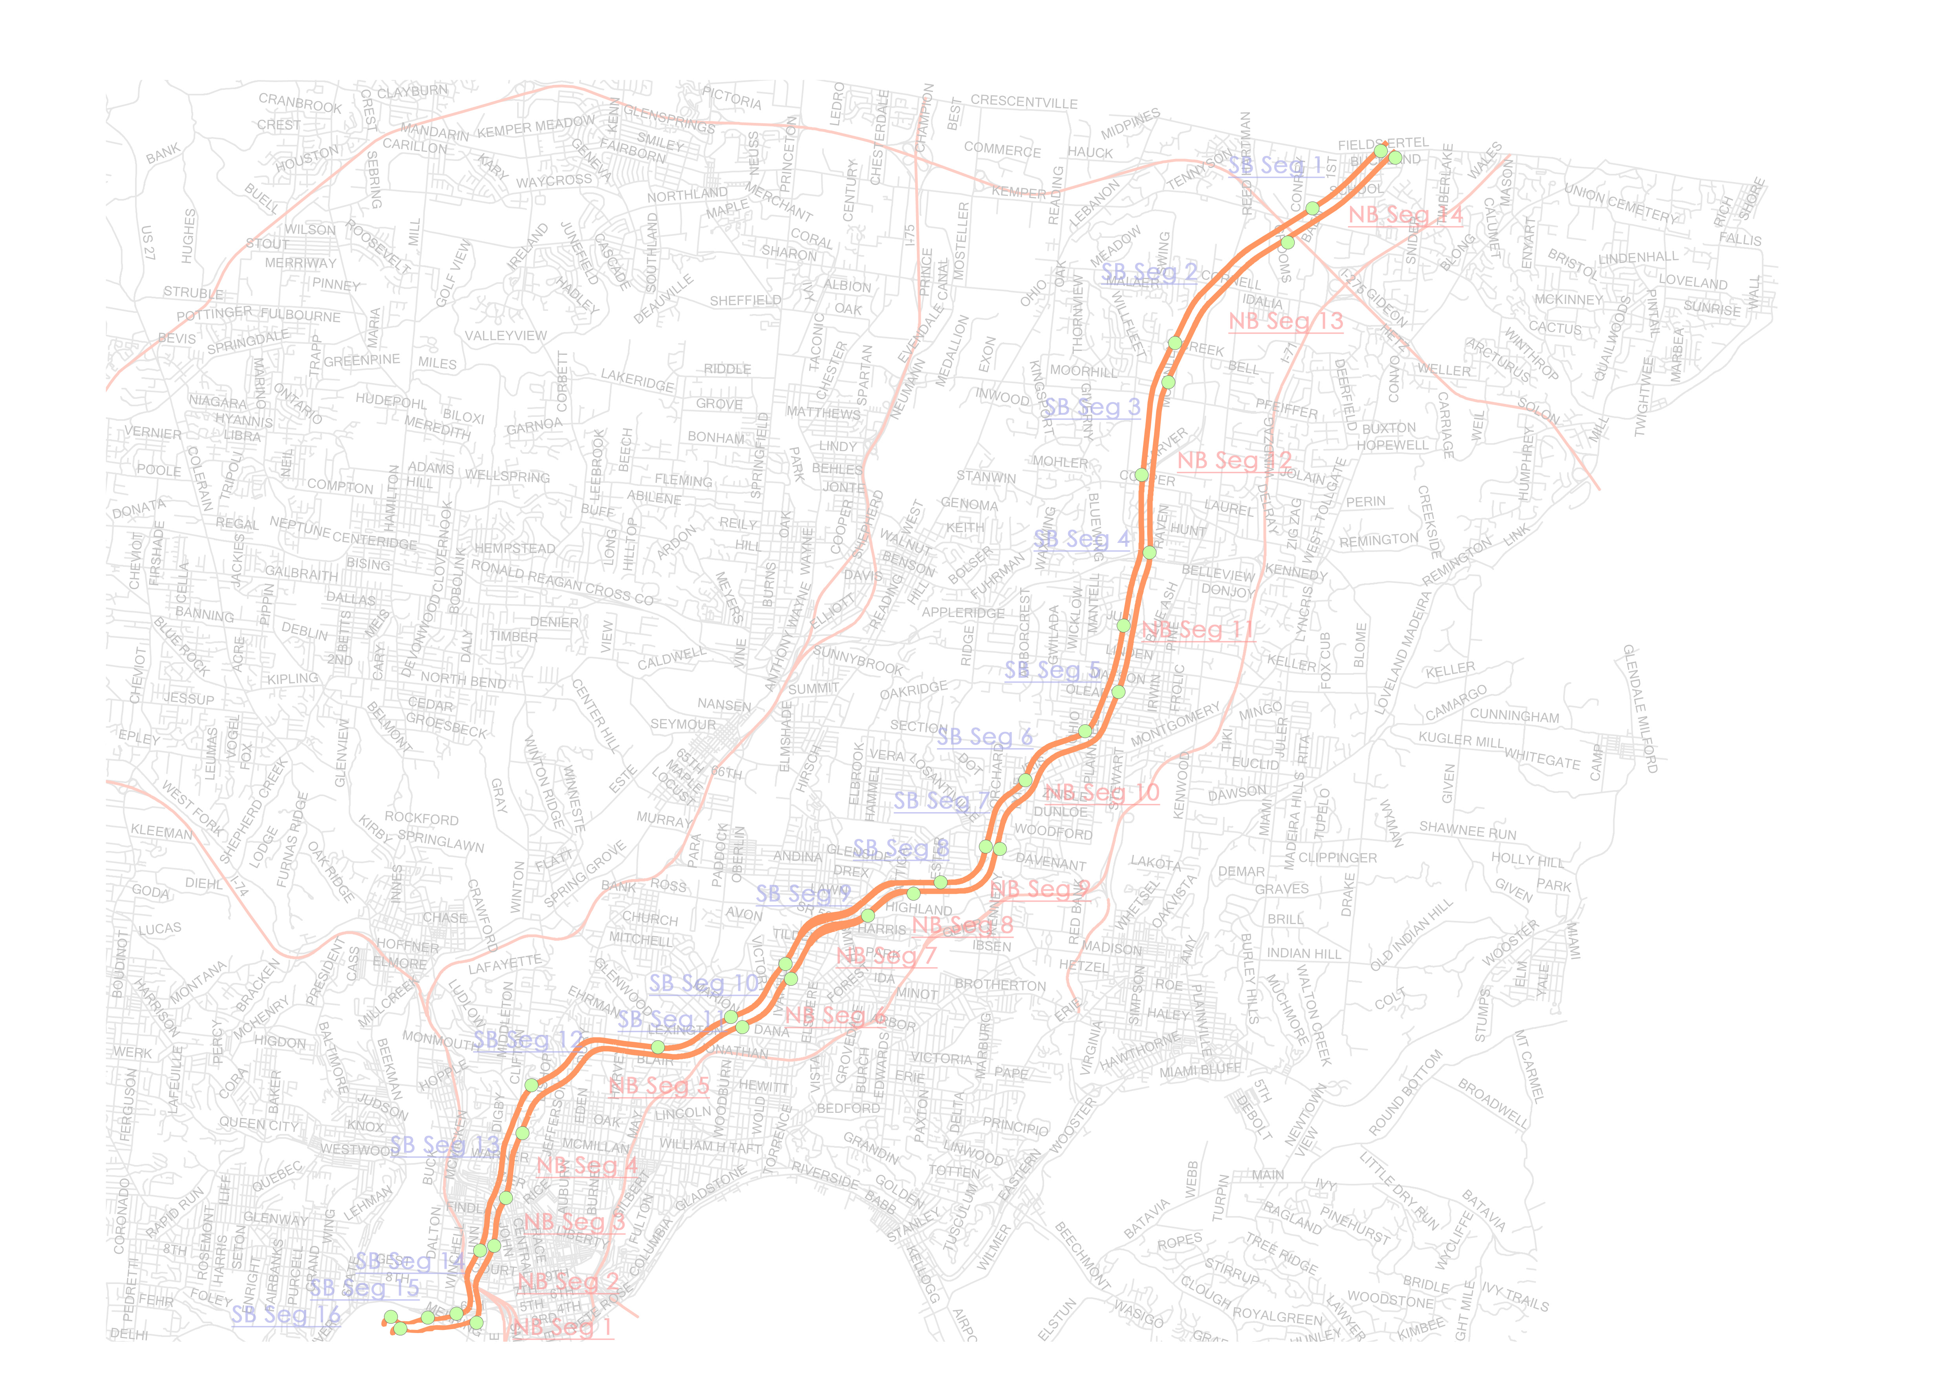
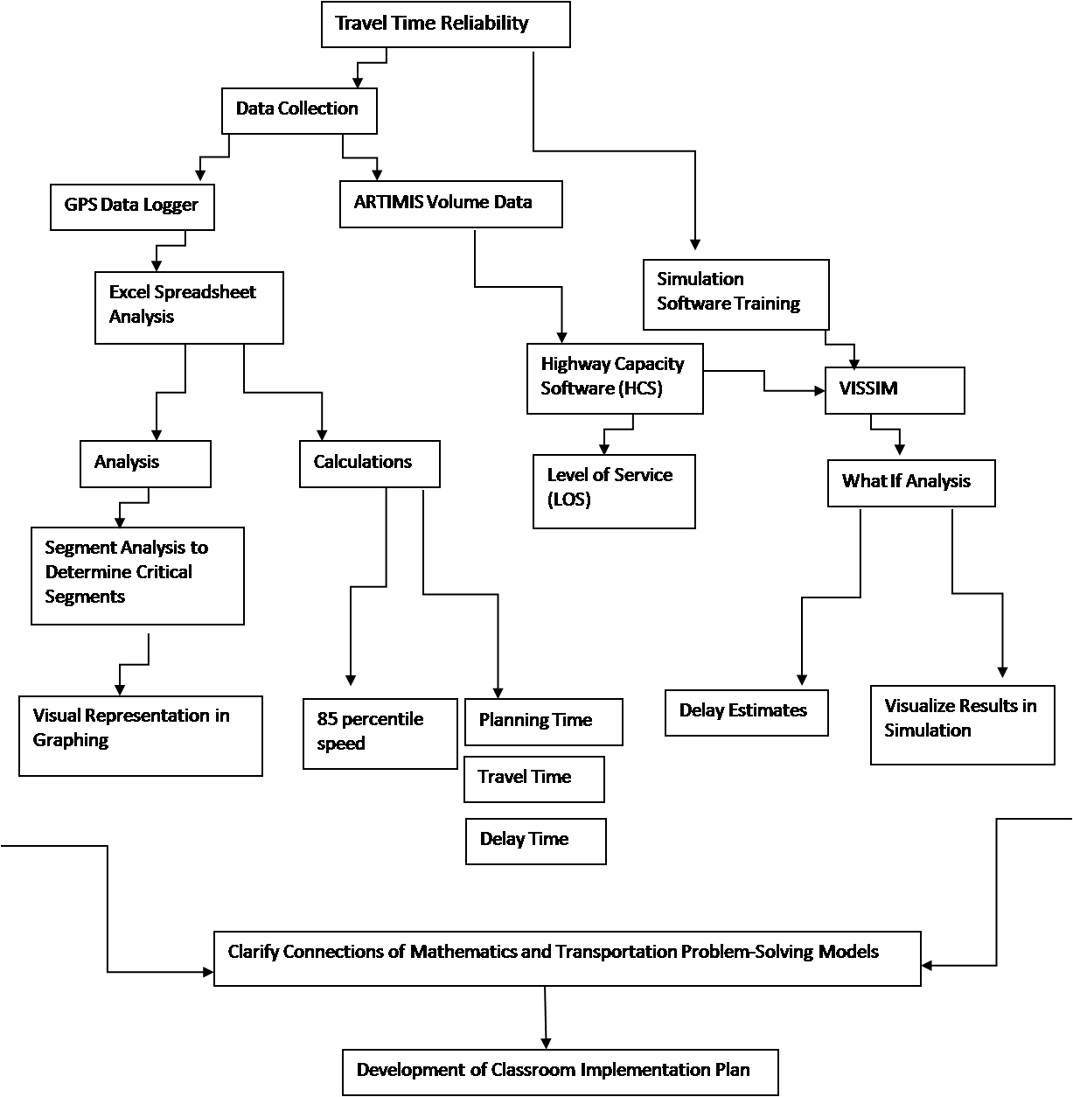
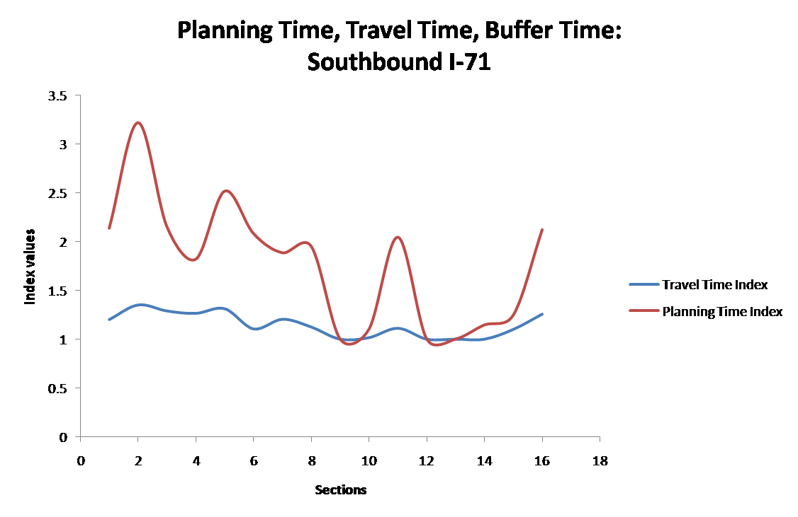
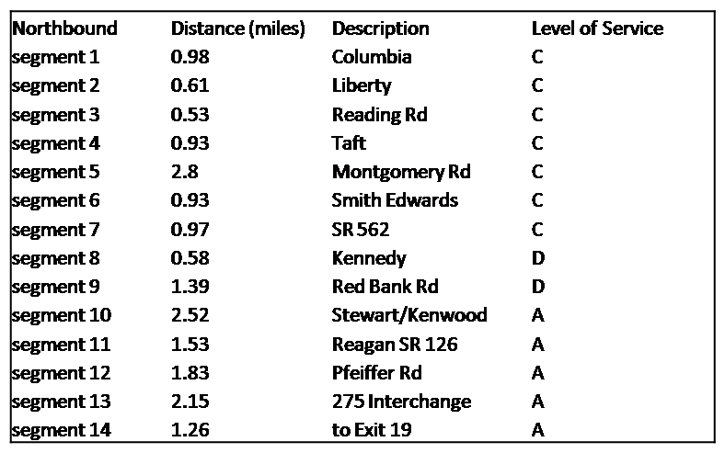
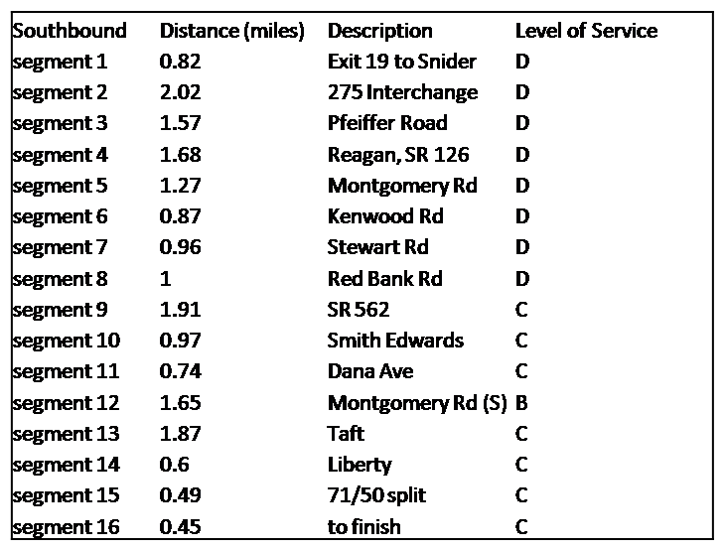
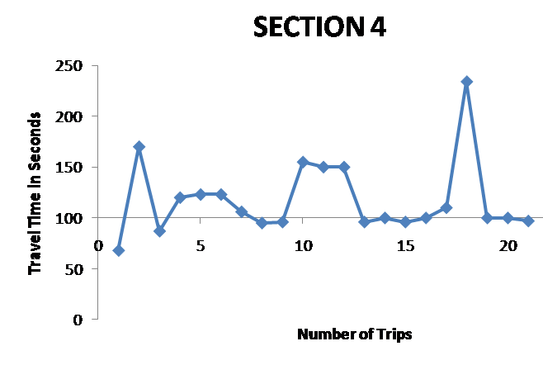
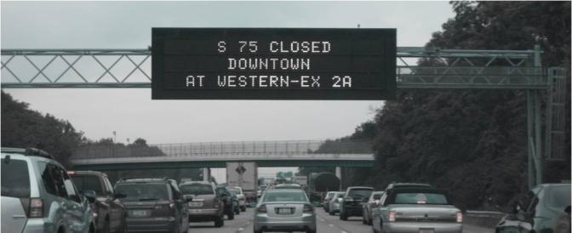
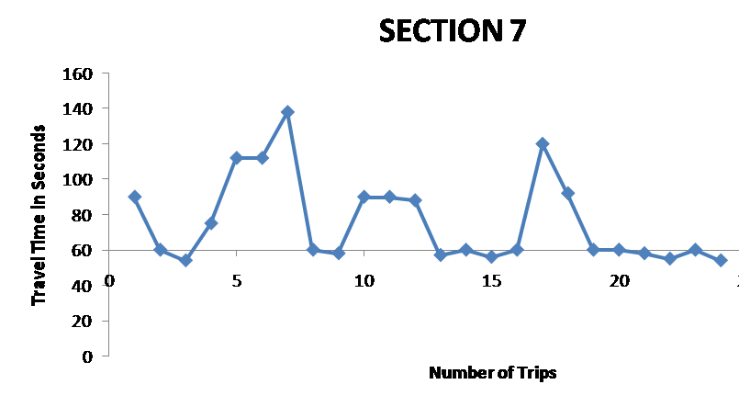
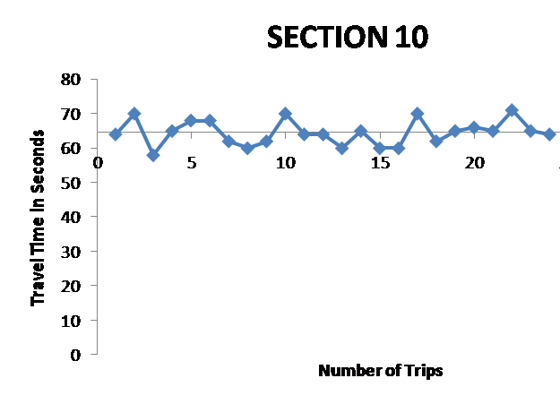
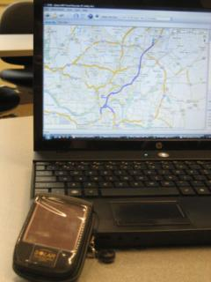
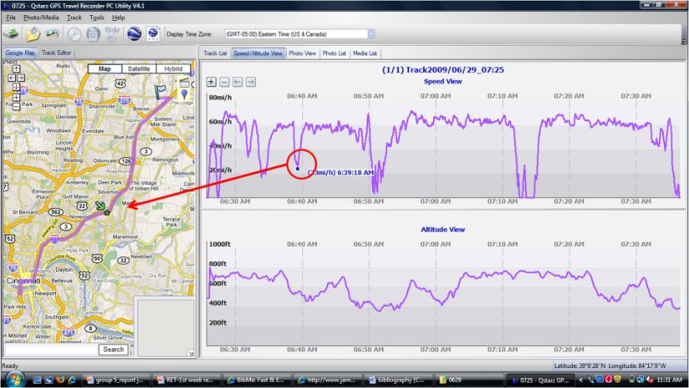
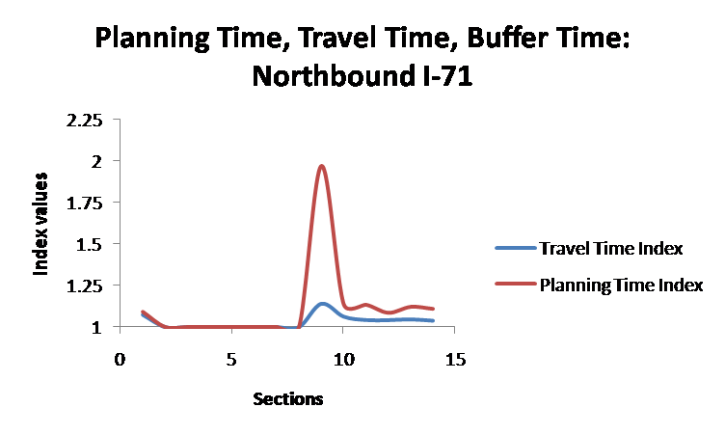
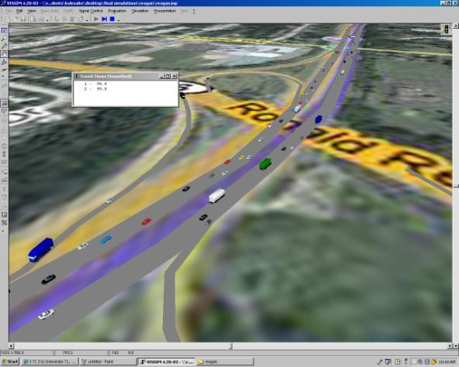
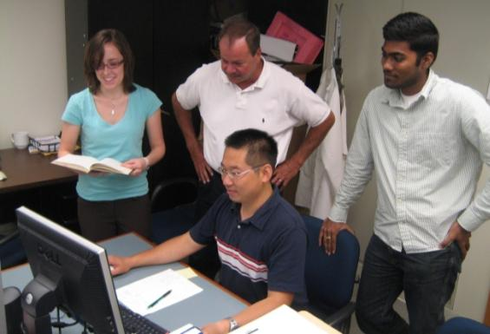
Measuring Travel Time Reliability of Transportation Systems
Brad Hunt¹, Kate Kulesa²
¹Norwood, OH, Norwood High School; ²Cincinnati, OH, Xavier University
Abstract
When traveling people want to be on time and avoid any traveling delays. We worked to determine travel time reliability along the I-71 corridor. This study will provide a buffer time index that will determine specific travel times along different segments of I-71. We analyzed the stability of the quality of service of this particular transportation system is supposed to provide to its users was analyzed. An advanced GPS data collection method was used to provide travel times along specific segments of I-71 along with volume data from ARTIMIS surveillance video. We expect to find travel time reliability and average delay times using the 85th percentile travel speed, and the 95th percentile of travel times. Furthermore, we determined the critical segments of the trips and calculated how this affects the travel time, buffer time, and the planning time. Finally, to predict within 95% probability the travel time along I-71. As an example, the buffer time of 12 min and 17 sec is needed to achieve a 95% on time arrival rate on the southbound I-71 section.
Research Methods
Results
Conclusion
Due to the Level of Service rating of C and D on the southbound section of I-71, it is apparent that further study of segments 4 and 7 be conducted to minimize the effects of current volume levels and improve the LOS rating. Future increase in volume along this section will result in a LOS rating falling below the acceptable rating of D. This will increase the buffer time needed for commuters to arrive on time. It should be noted that this study was conducted during the summer months where volume levels are lower during rush hour.
Buffer Time
Southbound critical segments
Introduction
Transportation Engineers work in a field where they must collect and analyze data and compare it to some of the data that has been collected by various organizations, such as ODOT in Ohio. After collecting the data and analyzing it, engineers think about hypothetical situations of ways to improve traffic and keep congestion to a minimum.
Tools used:
GPS data loggers
Jamar traffic counters
Petra Pro software
Microsoft Excel
Highway Capacity software (HCS)
VISSIM simulation software
Buffer Time is 95% On Time
Experimental Strategy
GPS Data Through Travel Navigation Software
Recorded trip
Time/Velocity graph
Acknowledgements
Zhuo Yao, Ph.D. Student
Vijay Krishna Nemalapuri, MS Student
Heng Wei, Ph.D., P.E., Assistant Professor
Reliable segment
References
Box, P. C., and Oppenlander, J. C. (1976). Manual of traffic engineering studies. Institute of Transportation Engineers, Arlington, Virginia.
Garber, N. J., Hoel, L. A., and Sadek, A. W. (2008). Transportation Infrastructure Engineering: A Multimodal Integration. Thomson Nelson, Chicago.
Gazis, D. C. (1974). Traffic Science. Wiley-Interscience, .
Roess, R. P., Prassas, E. S., and McShane, W. R. (2004). Traffic engineering. Prentice Hall, New York.
Schrank, D., and Lomax, T. (2007). "The 2007 Urban Mobility Report." Texas Transportation Institute, .
Texas Transportation Institute. (2006). "Travel Time Reliability: Making It There on Time, All the Time." .
Buffer Time
GPS data logger linked to Travel Navigation software

