Slide 1


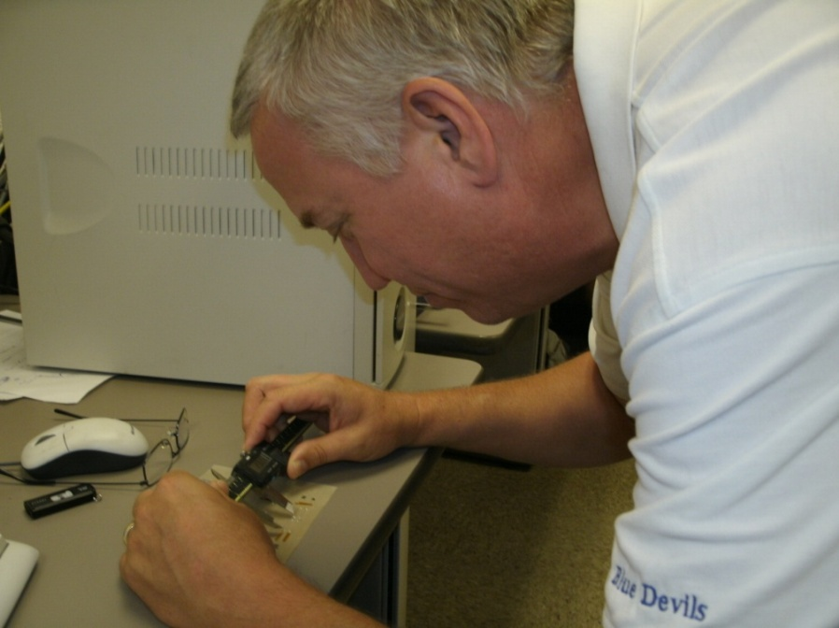
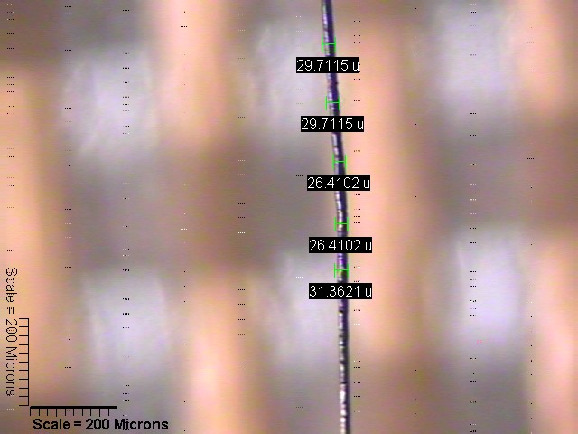
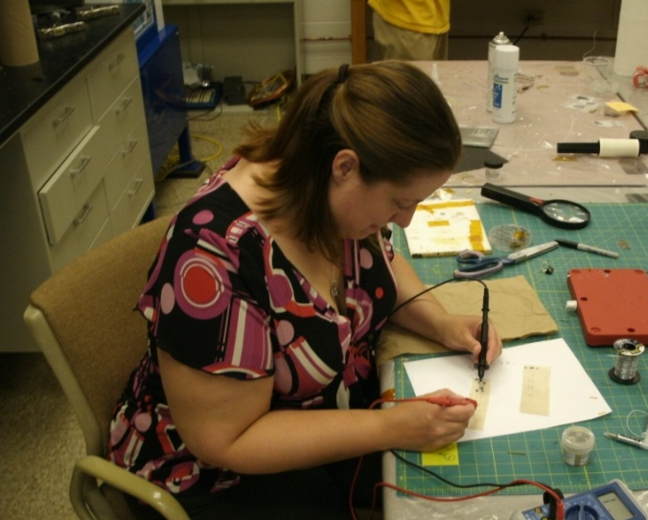
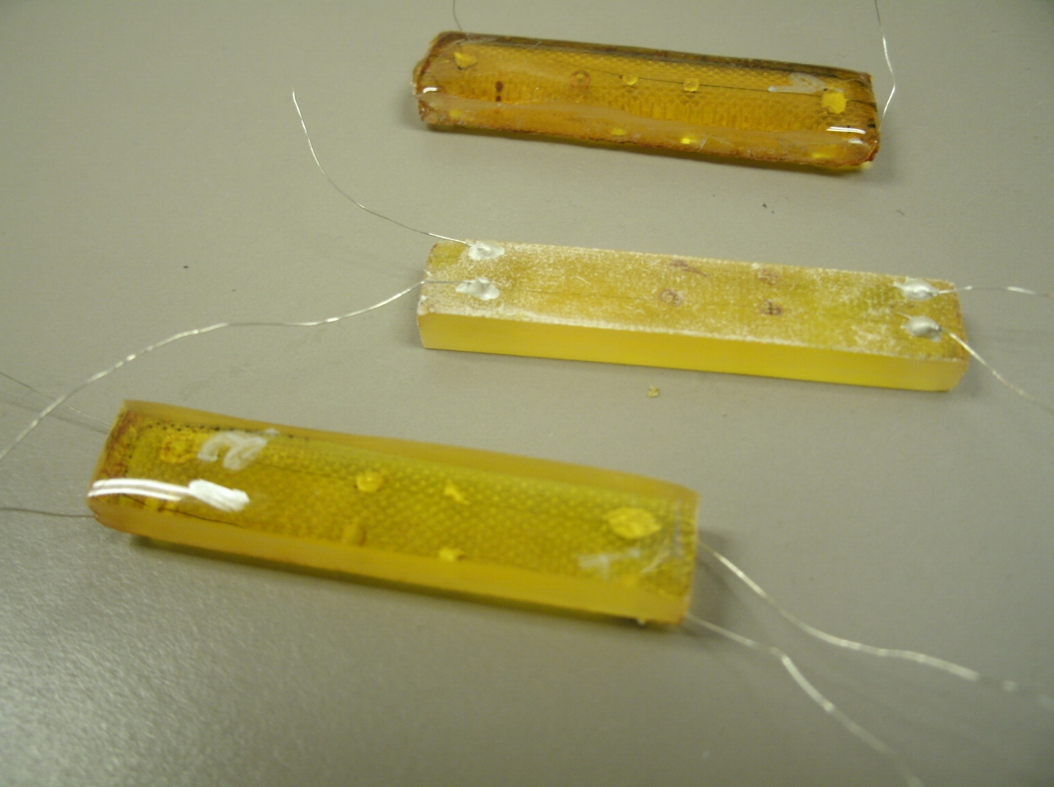

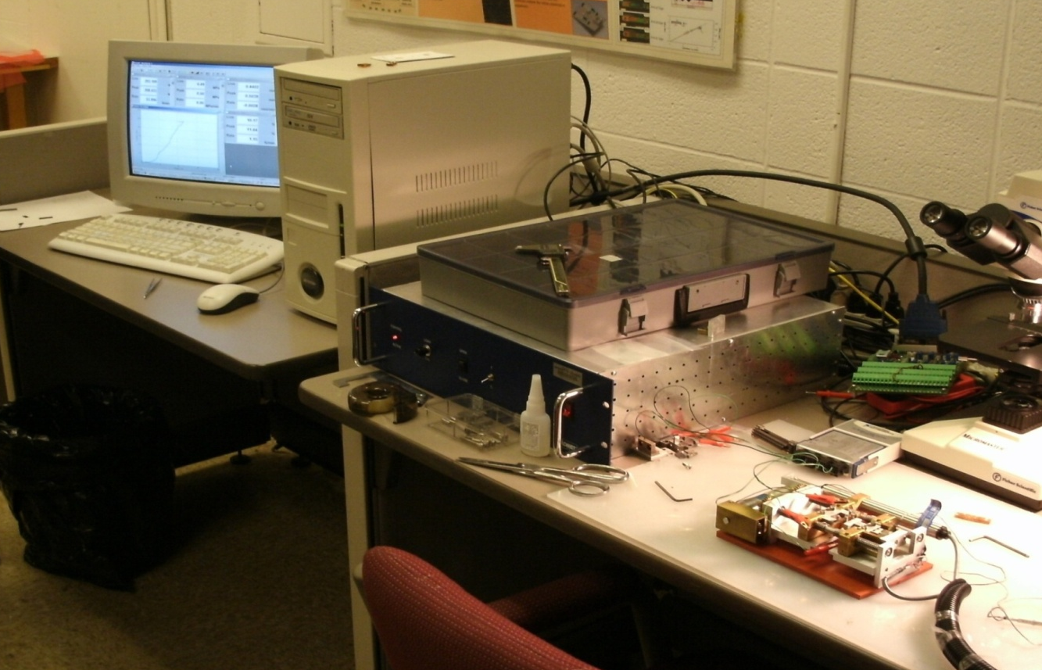
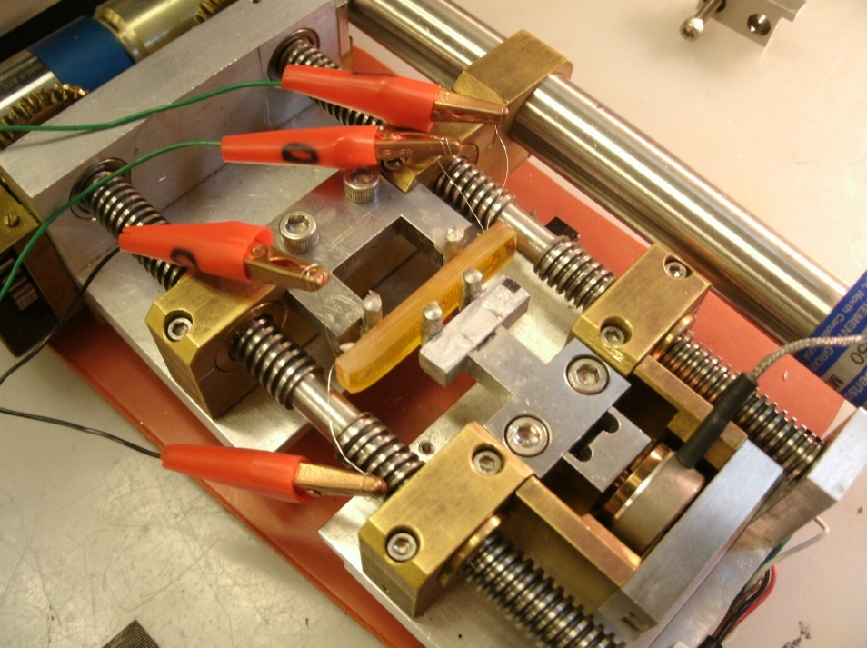
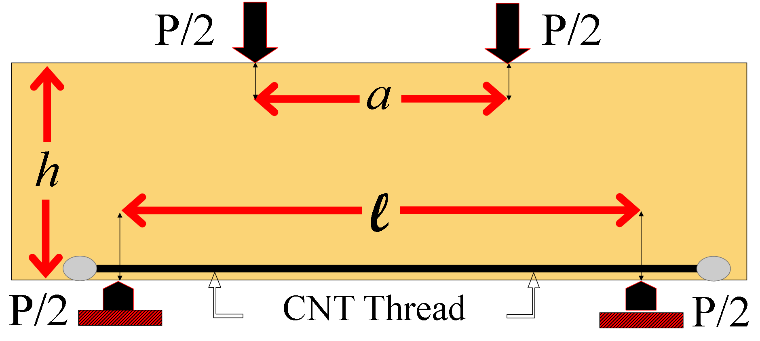
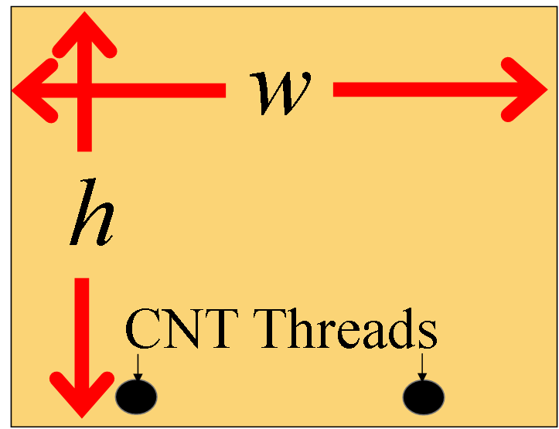
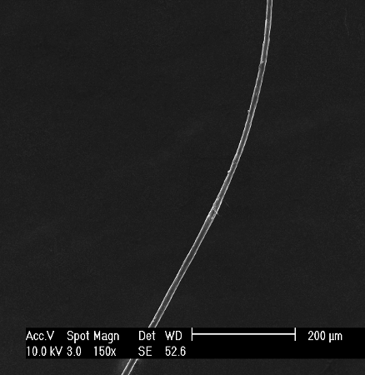
Smarter & Safer Composite Materials:
Strain Monitoring in Composite Materials Using Carbon Nanotube Thread
Michael Day¹, Sarah Woodward², Jandro Abot³, Yi Song³, Sandeep Medikonda³
¹Reading High School, Cincinnati, OH; ²Woodward Career Technical High School, Cincinnati, OH
³Department of Aerospace Engineering and Engineering Mechanics
Problem
Composite material have incredibly high stiffness and strength; however, cracks and delamination can lead to premature failure.
Research Methodology and Results
Characterize CNT thread for length, diameter and resistance
Fabricate a polymer composite incorporating a conductive carbon nanotube thread
Test composite sample under 4-point bending to determine strain and resistance
Analyze strain and resistance data for correlation
Solution
Carbon nanotubes threaded throughout the composite material to detect any type of failure.
A
Conductive epoxy
Summary
Composite materials were instrumented with CNT thread sensor and mechanically and electrically characterized.
a
b
c
B
CNT Thread
L
Conclusions
CNT thread is sensitive to changes in stress
Resistance (resistivity) is recovered after one cycle.
Strain resistance curve exhibits a quasi-linear response
Sensitivity of CNT thread varies slightly with number of cycles
Objective
Evaluate the ability of carbon nanotube (CNT) thread sensors to continuously monitor the state of strain in composite materials.
Mechanical
4-point Bending
Displacement
Control
Acquire Load (P)
Electrical
Acquire
Resistance (R)
Abstract
Many approaches for in-situ structural health monitoring (SHM) have been proposed in literature to provide more frequent damage monitoring. These techniques are not cost effective for large composite structures. Composite materials were instrumented with CNT thread sensor without altering the structure of the material to provide the state of strain in real time. The operation of the sensors is governed by electrical impedance spectroscopy. Composite samples were mechanically and electrically characterized under 4-pt bending to determine strain, stress and resistance over time. We correlated the strain with the resistance to obtain the gage factor for the CNT threads sensor.
References
Abot, J. L., Song, Y., Schulz, M. J. and Shanov, V. N. Novel carbon nanotube array-reinforced laminated composite materials with higher interlaminar properties. Compost. Sci. Technol. 68 (13): 2755-2760 (2008).
Daniel, I. M. and Ishai, O. Engineering mechanics of composite materials, 2nd ed., Oxford, New York, NY (2006).
Mallik, N., Schulz, M. J., Shanov, V. N., Hurd, D., Chakraborty, S., Jayasinghe, C., Abot, J. L. and Song, A. Study on carbon nano-tube spun thread as piezoresistive sensor element. Adv. Mater. Res. 67 (13): 155-160 (2009).
Kang, I., Maheshwari, G., Yun, Y. -H., Shanov, V., Chopra, S., Abot, J., Choi, G., Schulz, M. J. Nanoengineering of Sensory Materials, Encyclopedia of Structural Health Monitoring, edited by C. Boller, F. -K. Chang, and Y. Fujino, Wiley (2009).
Kroto, h. (1988). Space, Stars, C60 and Soot. Journal of Science, 242, 1139-1145. Retrieved July 1, 1988, from http://www.jstor.org/pss/1702631
Acknowledgements
We would like to thank The University of Cincinnati and the National Science Foundation For this opportunity as well as the support staff:
A. Kukreti, PhD
A. Burrows, PhD Candidate
J. Abot, PhD
Yi Song, PhD Candidate
Sandeep Medikonda, PhD Student
Stress-Strain behavior of polymer
ESEM image of CNT Thread

