Slide 1
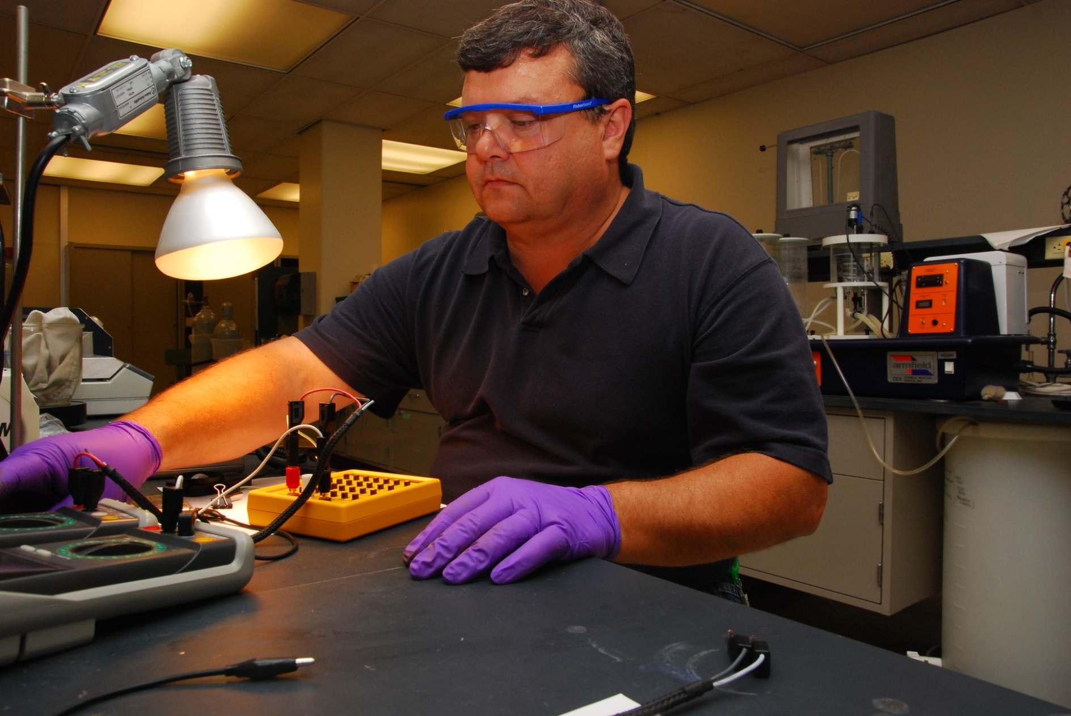
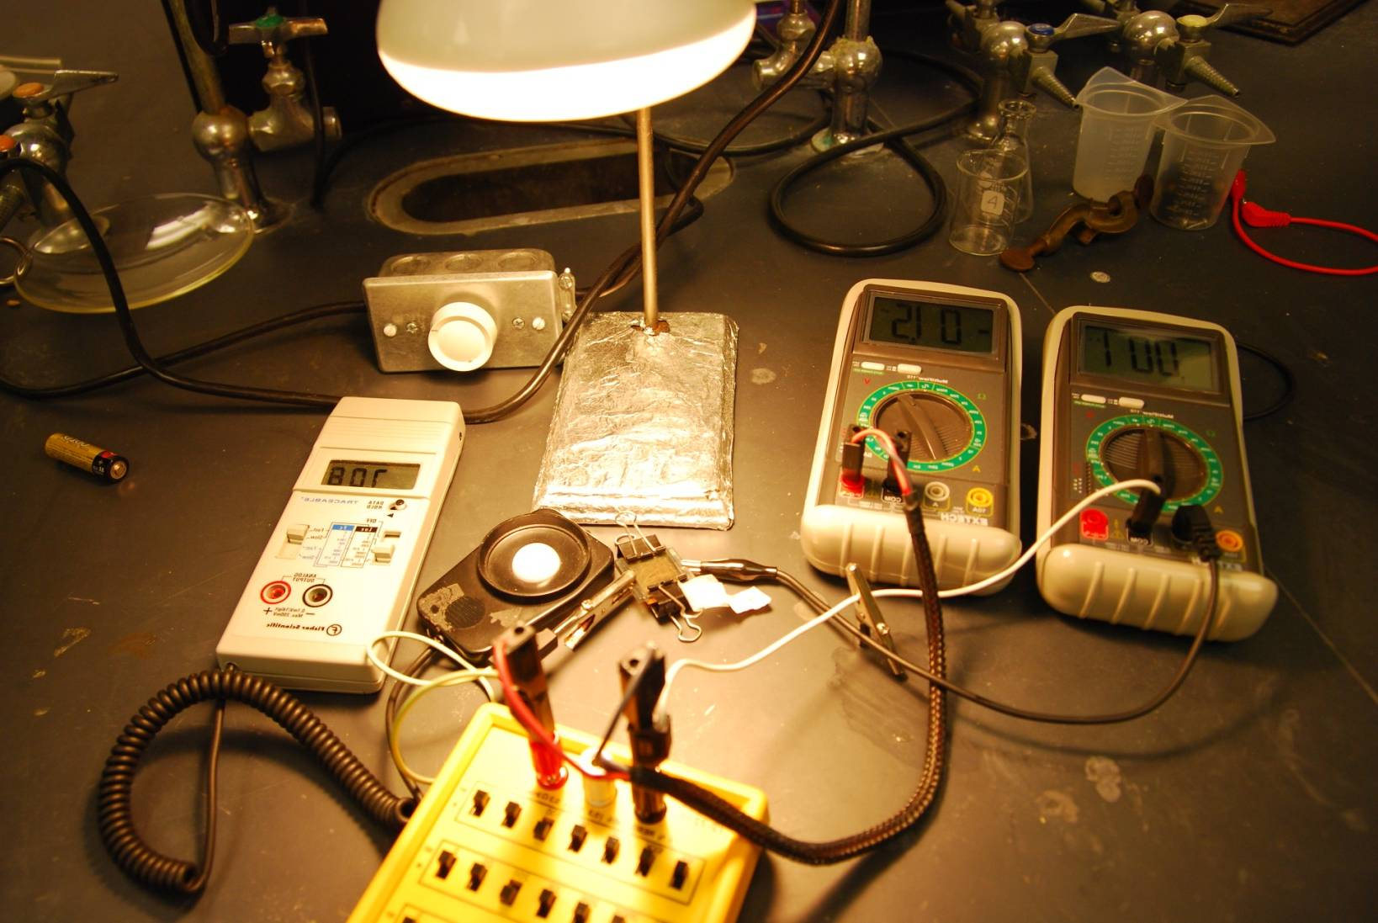
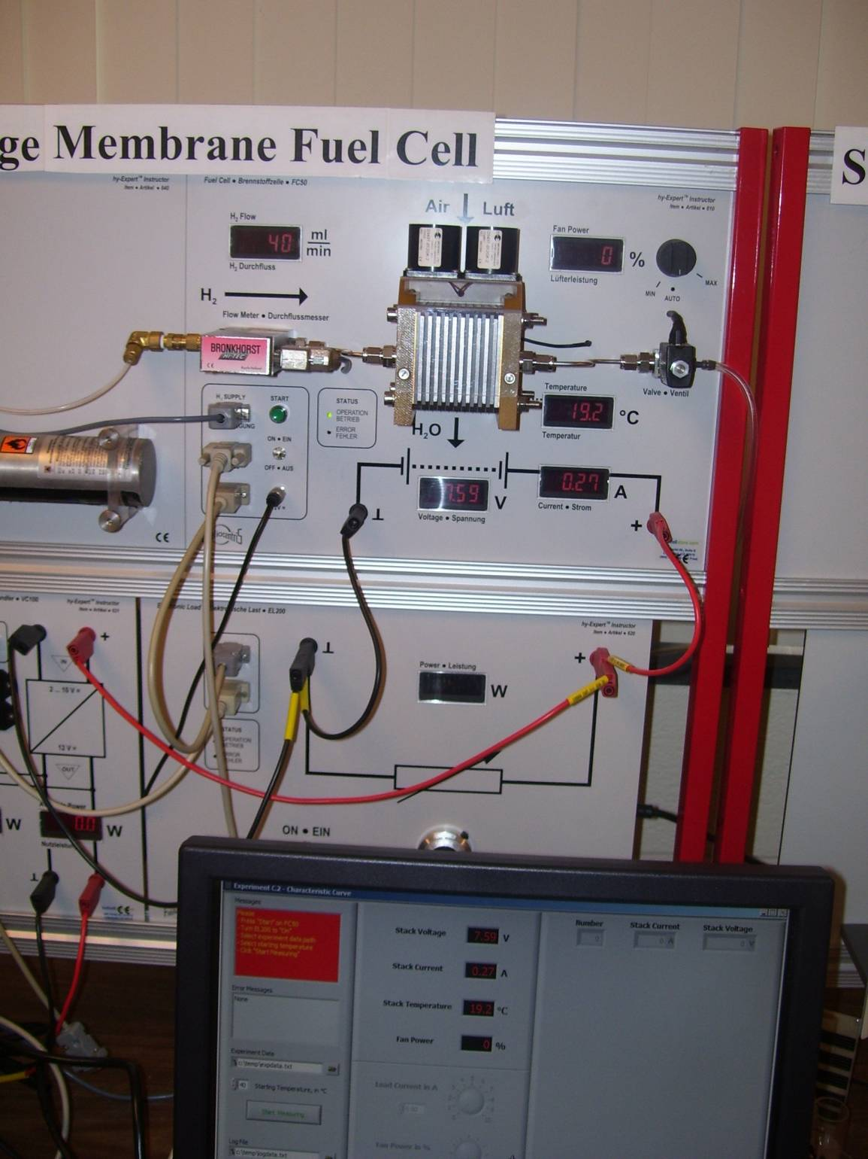
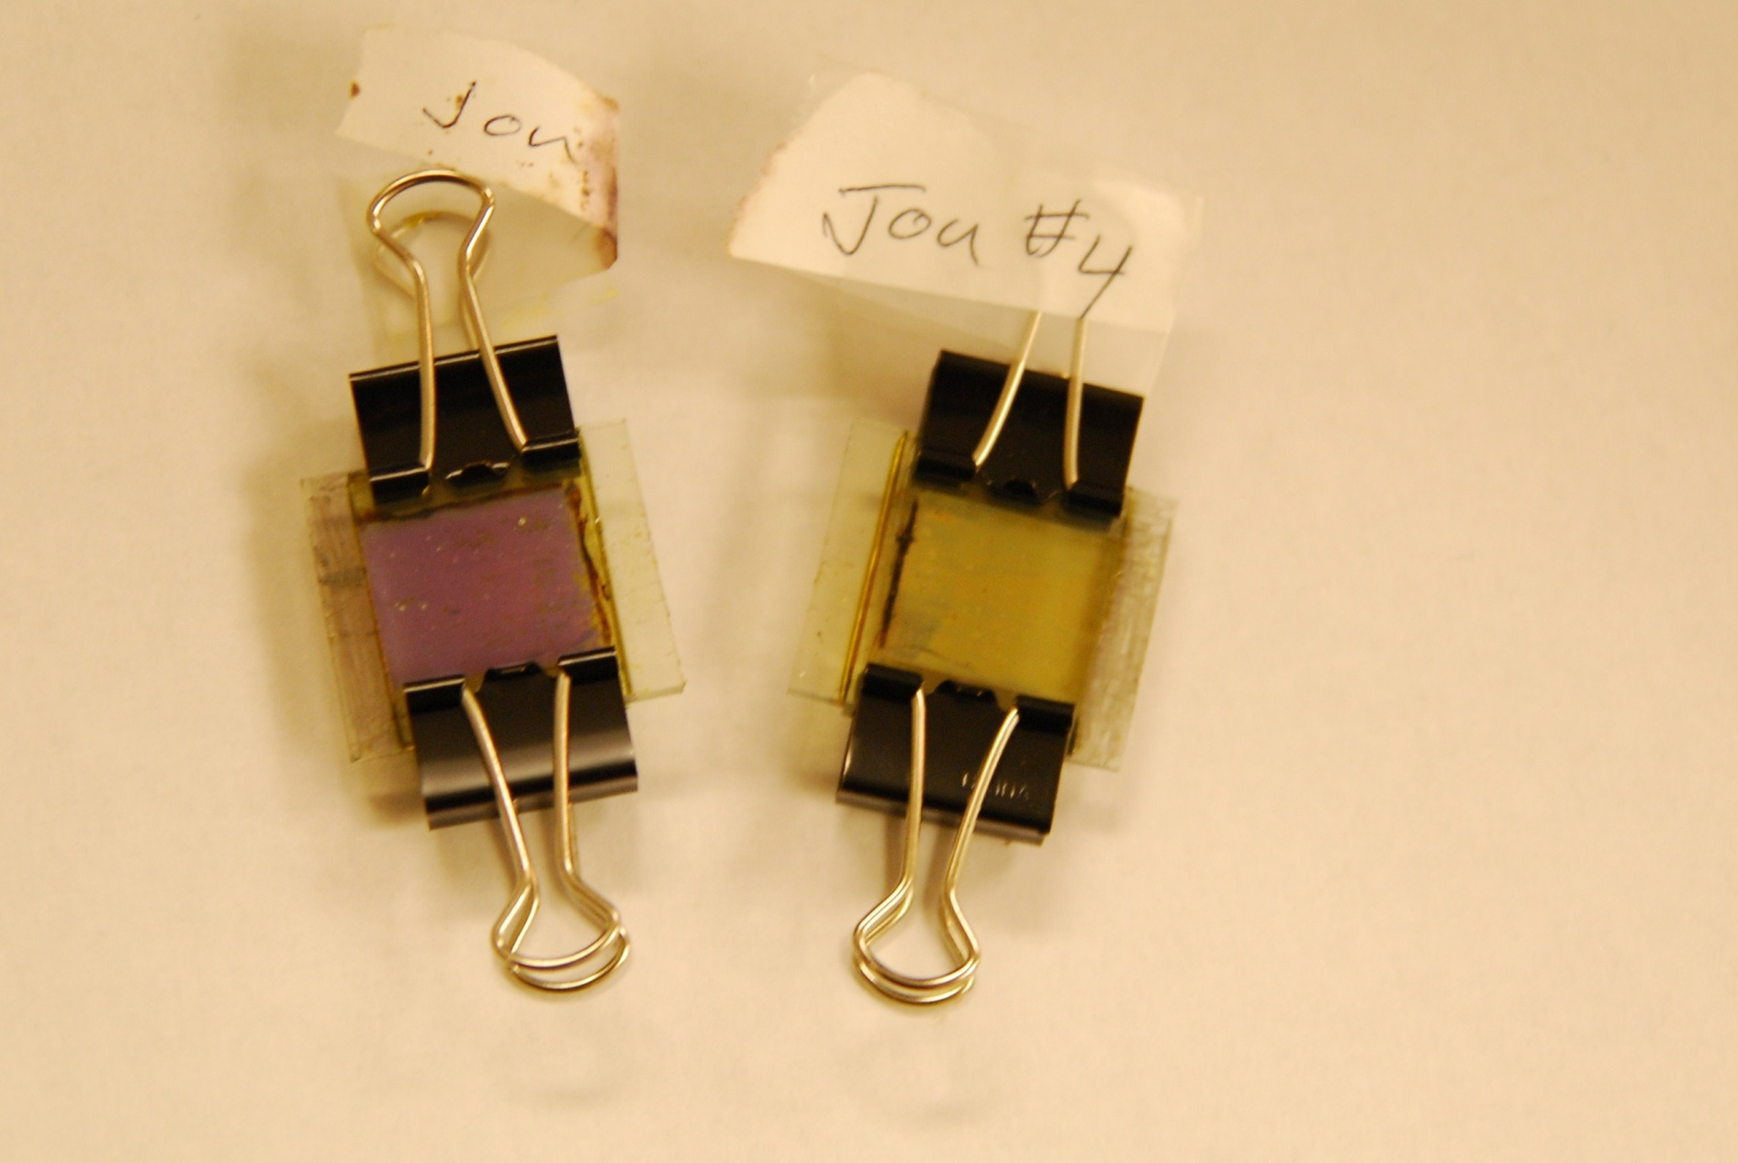
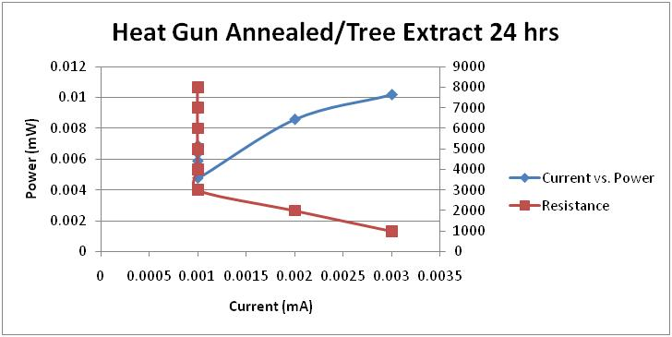
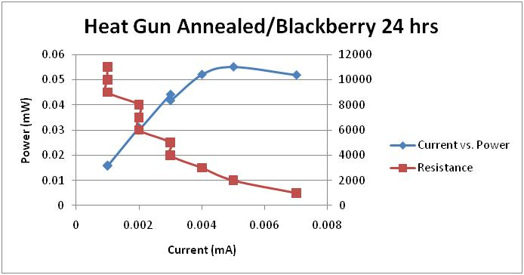
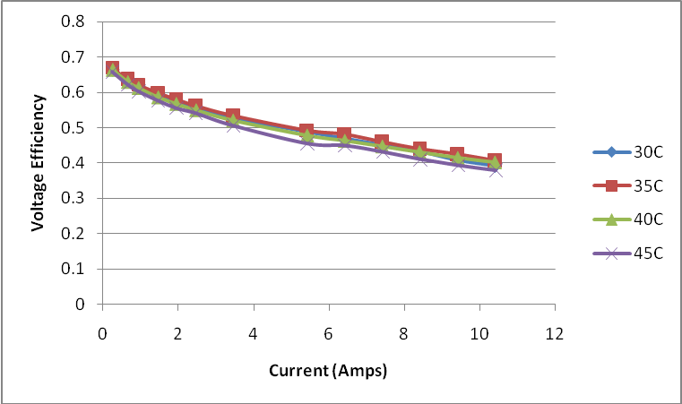
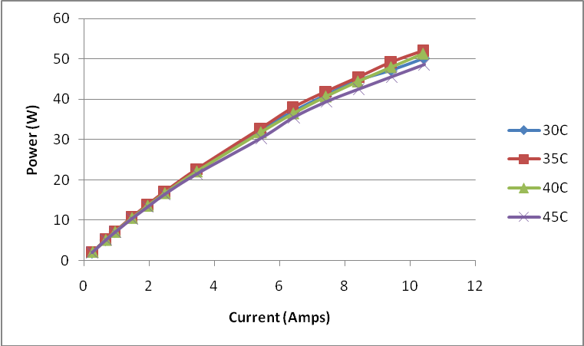
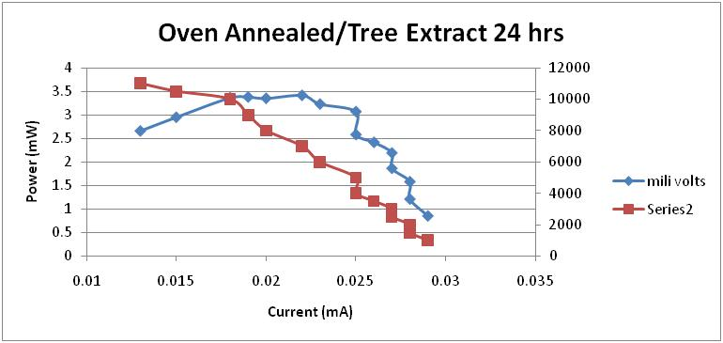
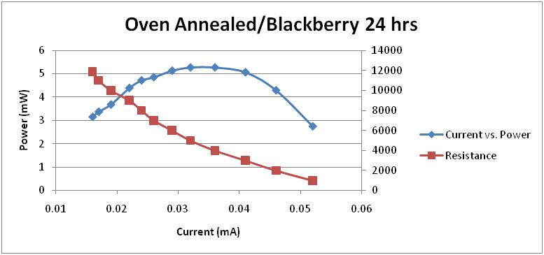
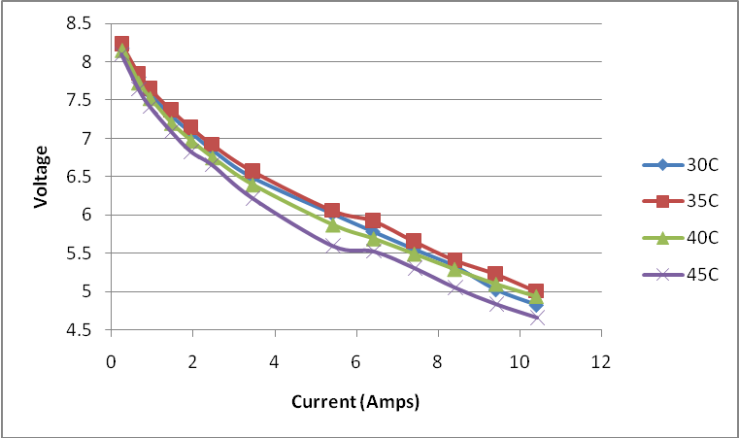
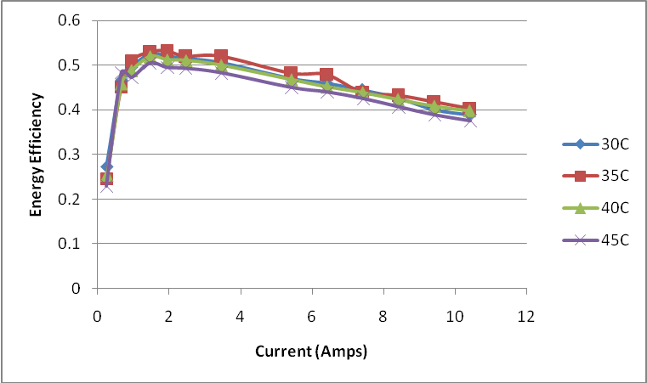
The Future of Energy: Hydrogen Fuel Cells and Solar power
²Philip Mercatili, ³Jon Souders, ¹Feng Wang M.S., ¹Vesselin Shanov, Ph.D.
¹University of Cincinnati Chemical & Materials Engineering, Cincinnati, OH.
²University of Cincinnati Teacher Education Student, Intern at Glen Este 2009-2010
³Glen Este High School, Cincinnati, OH, School for Scientific Studies
Methods
Experiment #1: Testing different dyes, both organic and synthetic dyes in dye-sensitized TiO₂ solar cells to determine the most efficient dyes.
Glass panels are coated with SnO₂ on one side for conductivity are coated with TiO₂, annealed at 450C, coated with dye, and held together with binder clips.
A light is shown on the cell and measurements are taken using multimeters in a circuit
Methods
Experiment #2: Testing a hydrogen fuel cell stack (10) at different temperatures to determine which results in the most efficient energy production
Using a stack of fuel cells at different temperatures and pre-compressed hydrogen we test the energy, current, and voltage efficiencies along with the power output to determine the best temperature at which a fuel cell operates
Results (Experiment #2)
At 45C the cell's power, voltage, voltage efficiency, and current efficiency all start to fall off compared to the other temperatures.
Abstract/Introduction
The search for new, cleaner sources for energy is becoming increasingly important in today’s society
Today’s resources are dwindling as demand increases.
Many problems can be solved by making these technologies cheap and available
The main problems with the technology are the lack of mass production and distribution networks
Most research is now being done to improve efficiency and refine the technology already available
Discussion
Hydrogen fuel cells and solar power will continue to be at the forefront of green technologies
The significant investments into these technologies will most likely only increase in the coming years
Our experiments show that even very small, basic improvements into some of the core components can have a drastic effect on the efficiency
Acknowledgements
We would like to thank Dr. Vesselin Shanov and Feng Wang for helping us direct our I terests and training us in the use of the setups. Also, we’d like to thank them for helping us with reference material in relation to our project. Also,we would like to thank the NSF for funding: Research Experiences for Teachers Site for “Civil Infrastructure Renewal and Rehabilitation” (Grant ID No. is EEC-0808696).
References
Cheng, X., Zhang, J, Tang, Y., Song, C., Shen, J., Song, D., Zhang, J., “Hydrogen crossover in high-temperature PEM fuel cells,” Journal of Power Sources, Volume 167, Issue 1, 1 May 2007, Pages 25-31
Ehret, A., Stuhl, L., Spitler, M.T. “Spectral Sensitization of TiO₂ Nanocrystalline Electrodes with Aggregated Cyanine Dyes,” J. Phys. Chem. Volume105, pp.9960-9965 (2001)
Mor, G.K., Karthik, S, Paulose, M., Varghese, O.K.., and Grimes, C.A. “Use of Highly-Ordered TiO2 Nanotube Arrays in Dye Sensitized Solar Cells,” Nano Letters 2006 Vol. 6, No 2, 215-218
Narayanan, S. R., Valdez, T.I.,* Firdosy, S. “Analysis of the Performance of Nafion-Based Hydrogen–Oxygen Fuel Cells,” Journal of The Electrochemical Society, volume156 . pp.B152-B159 (2009)
Scrivano G., Piacentino A., Cardona F. “Experimental characterization of PEM fuel cells by micro-models for the prediction of on-site performance,” Renewable Energy volume 34 (2009) pp.634–639
Yang C., Costamagna P., Srinivasan S., Benziger J., Bocarsly A.B. “Approaches and technical challenges to high temperature operation of proton exchange membrane fuel cells,” Journal of Power Sources. Volume 103 (2001) pp.1–9
Results (Experiment #1)
Our experiments showed us that the different dyes have different efficiencies but the process to produce the solar cells is much more important for the overall efficiency.
Voltage Efficiency vs. Current
Power vs. Current
Voltage vs. Current
Energy Efficiency vs. Current

