Slide 1



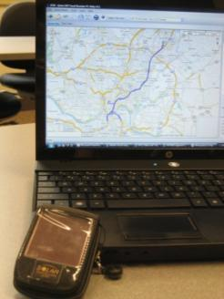

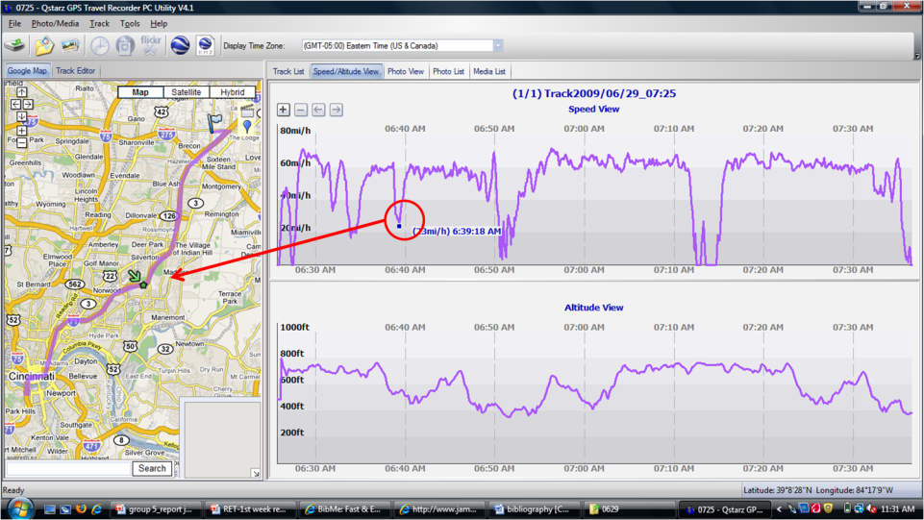
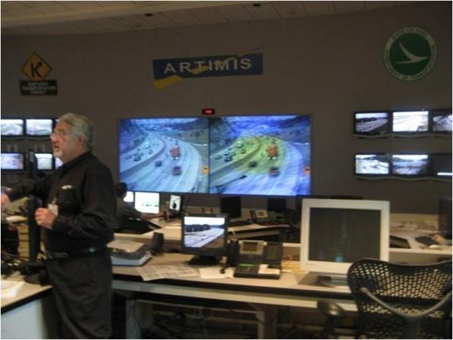
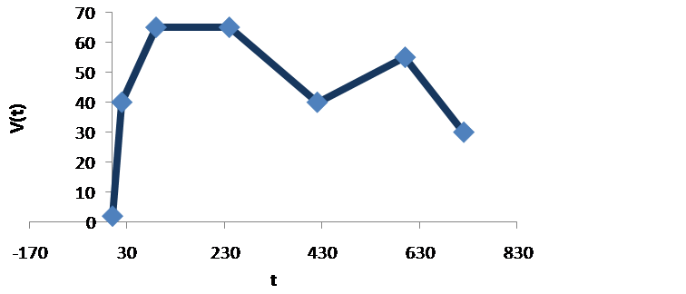

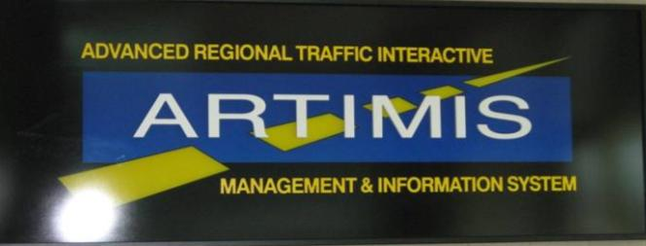

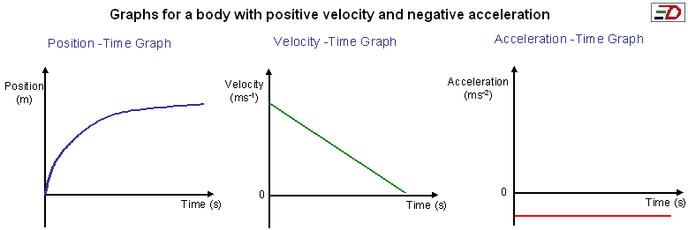
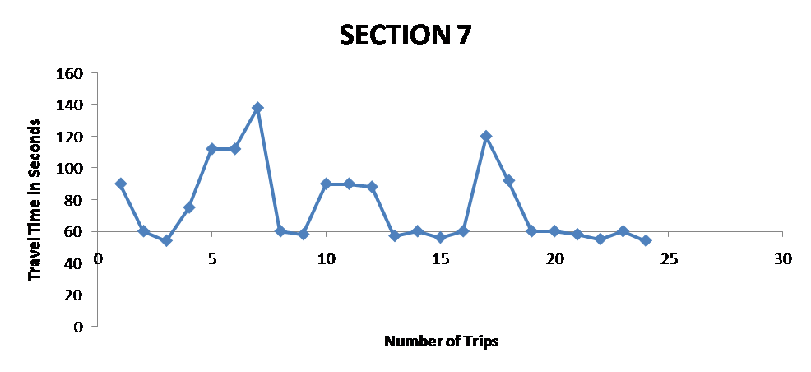
Traffic Analysis and Graphing
Brad Hunt¹, Kate Kulesa²
¹Norwood, OH, Norwood High School; ²Cincinnati, OH, Xavier University
5th Grade Objectives
Students will:
organize recorded data into a chart, or something similar
interpret graphs by reading specific points on the graph, as well as creating points on the graph
create a graph of their recorded data
determine the mean, median, and mode of their data
Introduction
Transportation Engineers work in a field where they must collect and analyze data and compare it to some of the data that has been collected by various organizations, such as ODOT in Ohio. After collecting the data and analyzing it, engineers think about hypothetical situations of ways to improve traffic and keep congestion to a minimum. Students will learn some basic vocabulary related to highway transportation.
12th Grade Calculus Objectives
Students will be able to:
graph a function from the graph of its derivative
graph a derivative from the graph of its function
graph the derivative of a function given numerically with data
interpret the area under the graph as a net accumulation of a rate of change.
Lesson Overview
Hands-on simulation of traffic
Walking in the hallway, entering and exiting classrooms (like highway ramps
Students brainstorm segmentation to measure time covered through a distance
relative scale of the level of traffic
collect data
display in a graph in order to complete an analysis of the data.
Lesson Overview
Engineering is the application of science for daily use.
Transportation is one such field where decisions influence people directly.
What kinds of problems occur on our highways?
How long are you on the highway?
Field Trip to ARTIMIS
Students will collect GPS data en route to ARTIMIS
Determine rates of change in the traffic patterns
Analyze traffic graph and area beneath
Activity Engagement
Concept map, teacher gives central idea
Calculation of how much time in a lifetime is spent in traffic
Applicable Strands and Benchmarks
Strands
Data Analysis and Probability
Measurement
Patterns , Functions and Algebra
Mathematical Process
Pie chart
Line graph
Activity
Students will collect GPS data en route
Determine rates of change in the traffic patterns
Analyze traffic graph and area beneath
Using Excel or a graphing calculator students will develop a time/velocity graph of a car trip from Norwood to the Kenwood Mall.
Students will determine their own time intervals.
histogram
Graphing
Activity
Students will segment the hallway and record the time it takes to walk each segment
Plot
points
data
numbers
Discussion
What does the slope of each segment represent?
When is the slope positive and negative?
What does the area under the graph represent?
Assessment
Analysis
Analyze graphs
Take recorded data and create a new graph
Compare and contrast various graphs
Can students interpret the value and meaning of points on a given graph?
Did students record data in a chart or organized manner?
Can students create their own graphs from data?
Exit slip
Assessment
Given a velocity graph students will be able to graph the acceleration and position graphs

